Slide 1


GO! with Microsoft 365®
Word 2025 Edition
Chapter 3
Creating Research Papers, Newsletters, and Merged Mailing Labels
Copyright © 2026, 2023, 2020 Pearson Education, Inc. All Rights Reserved
Notes:
If this PowerPoint presentation contains mathematical equations, you may need to check that your computer has the following installed:
1) Math Type Plugin
2) Math Player (free versions available)
3) NVDA Reader (free versions available)
GO! With Microsoft 365
Word 2025 Edition
Chapter 1: Creating a Worksheet and Charting Data

Slide 2
Learning Objectives
Create a Research Paper
Insert Footnotes in a Research Paper
Create Citations and a Bibliography in a Research Paper
Use Research Tools, Use Read Mode, and Save Documents in Alternate Formats
Format a Multiple-Column Newsletter
Use Special Character and Paragraph Formatting
Create Mailing Labels Using Mail Merge
Notes:
The objectives of this chapter are:
Create a Research Paper
Insert Footnotes in a Research Paper
Create Citations and a Bibliography in a Research Paper
Use Research Tools, Use Read Mode, and Save Documents in Alternate Formats
Format a Multiple-Column Newsletter
Use Special Character and Paragraph Formatting
Create Mailing Labels Using Mail Merge

Slide 3
Create a Research Paper
The two most commonly used styles for research papers are those created by the:
Modern Language Association (M L A)
American Psychological Association (A P A)
Notes:
Standard style guides—a manual that contains standards for the design and writing of documents—for research papers include Modern Language Association (M L A), American Psychological Association (A P A), and several others.

Slide 4
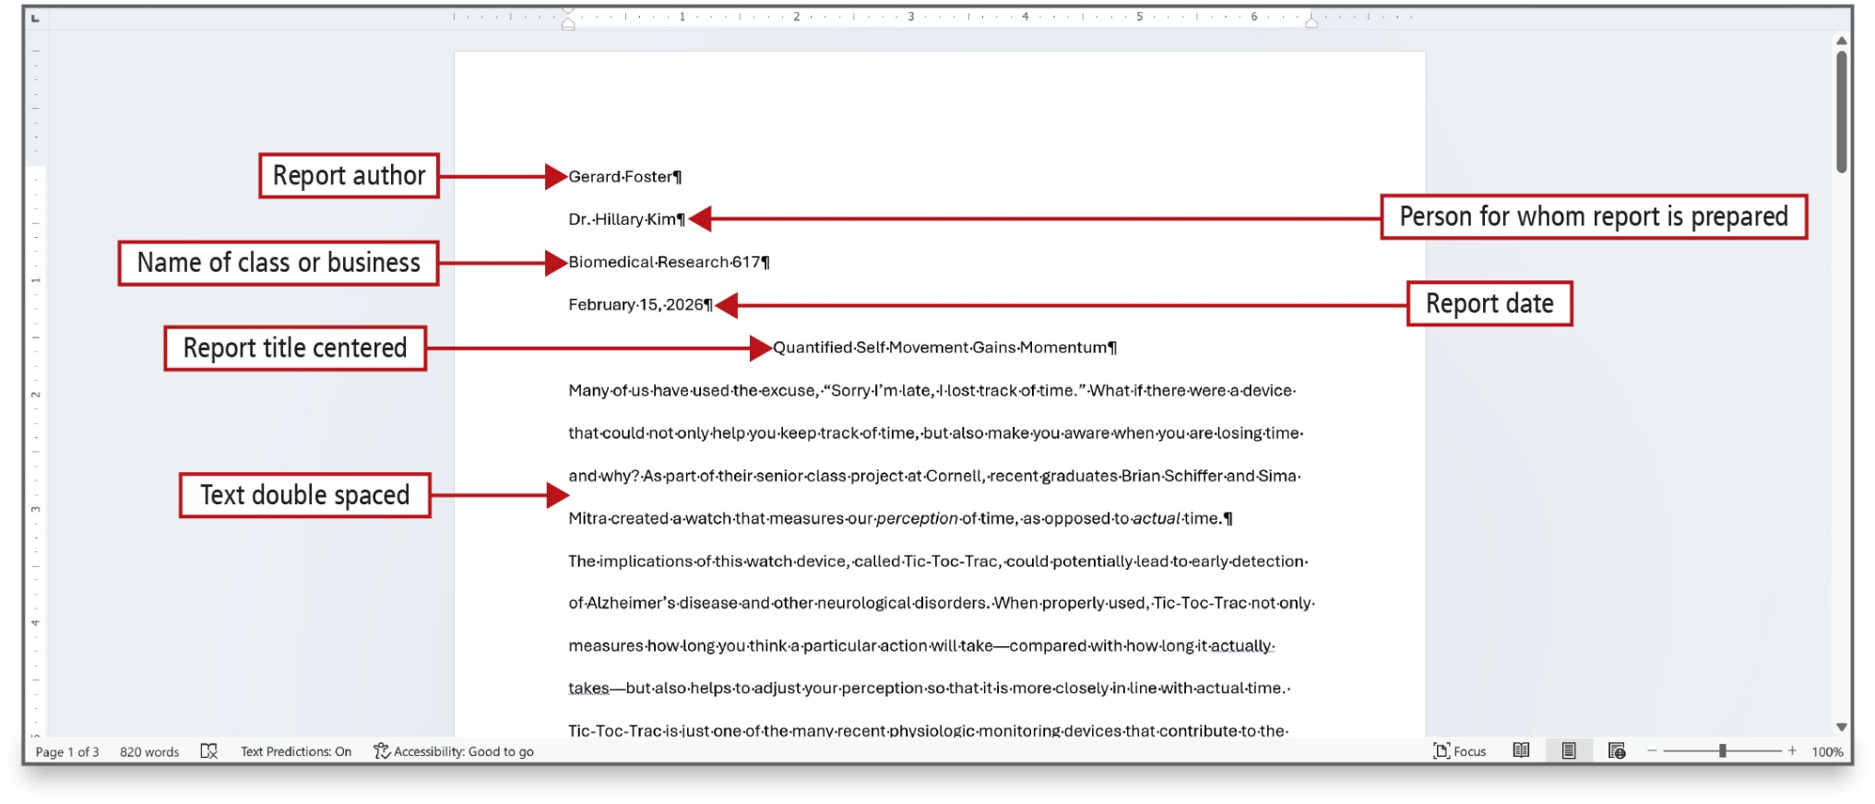
Figure 3.2
Notes:
An M L A paper, as shown here, uses 1-inch margins, a 0.5” first line indent, and double spacing throughout the body of the document, with no extra space above or below paragraphs. On the first page of an MLA-style research paper, on the first line, is the report author. The second line contains the person for whom the report is prepared. The third line is the class or business, the fourth, the date, and the fifth, the report titled, centered.
Long Description:
The first annotation, report author, points to Gerard Foster in the first line above the report title. The second annotation, person for whom report is prepared, points to Dr. Hillary Kim in the second line above the report title. The third annotation, name of class or business, points to Biomedical Research 617, in the third line above the report title. The fourth annotation, report date, points to February 15, 2026, in the fourth line above the report title. The fifth annotation, report title centered, points to Quantified Self Movement Gains Momentum in the report title. The sixth annotation, text double spaced, points to the text in the report.

Slide 5
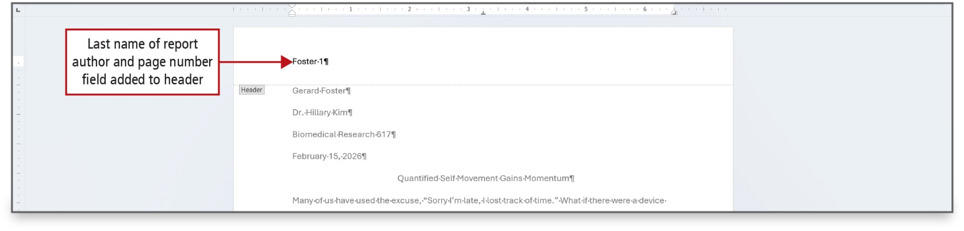
Figure 3.3
Notes:
The author’s last name and automatic page numbering should be in the header.

Slide 6
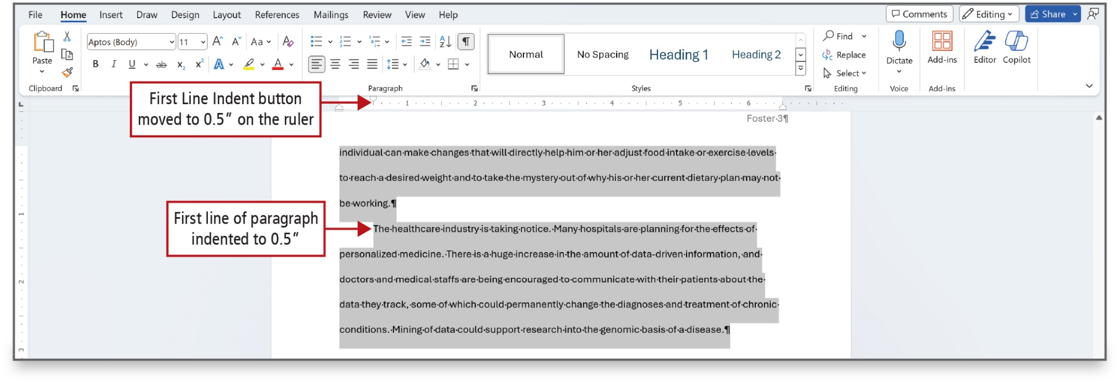
Figure 3.4
Notes:
M L A style uses 0.5-inch indents at the beginning of the first line of every paragraph. Indenting—moving the beginning of the first line of a paragraph to the right or left of the rest of the paragraph—provides visual cues to the reader to help divide the document text and make it easier to read.
Long Description:
The content of the report is selected. A ruler that ranges 0 to 6.4 in increments of 0.2 is shown below the ribbon. The first annotation, First Line Indent button moved to 0.5 inches on the ruler, points to 0.5 on the ruler. The second annotation, first line of paragraph indented to 0.5 inches, points to the starting portion of the second paragraph.

Slide 7
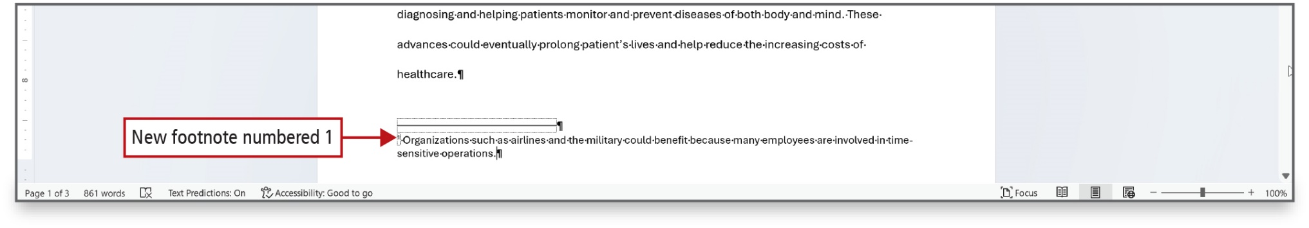
Figure 3.5
Notes:
A footnote is a note placed at the bottom of the page containing the note. Endnotes are notes placed at the end of a document or chapter. A footnote is shown on this figure with default formatting and a short solid, black line that separates the body of the report from the footnote. When you insert a new footnote, all remaining footnotes are automatically renumbered.

Slide 8
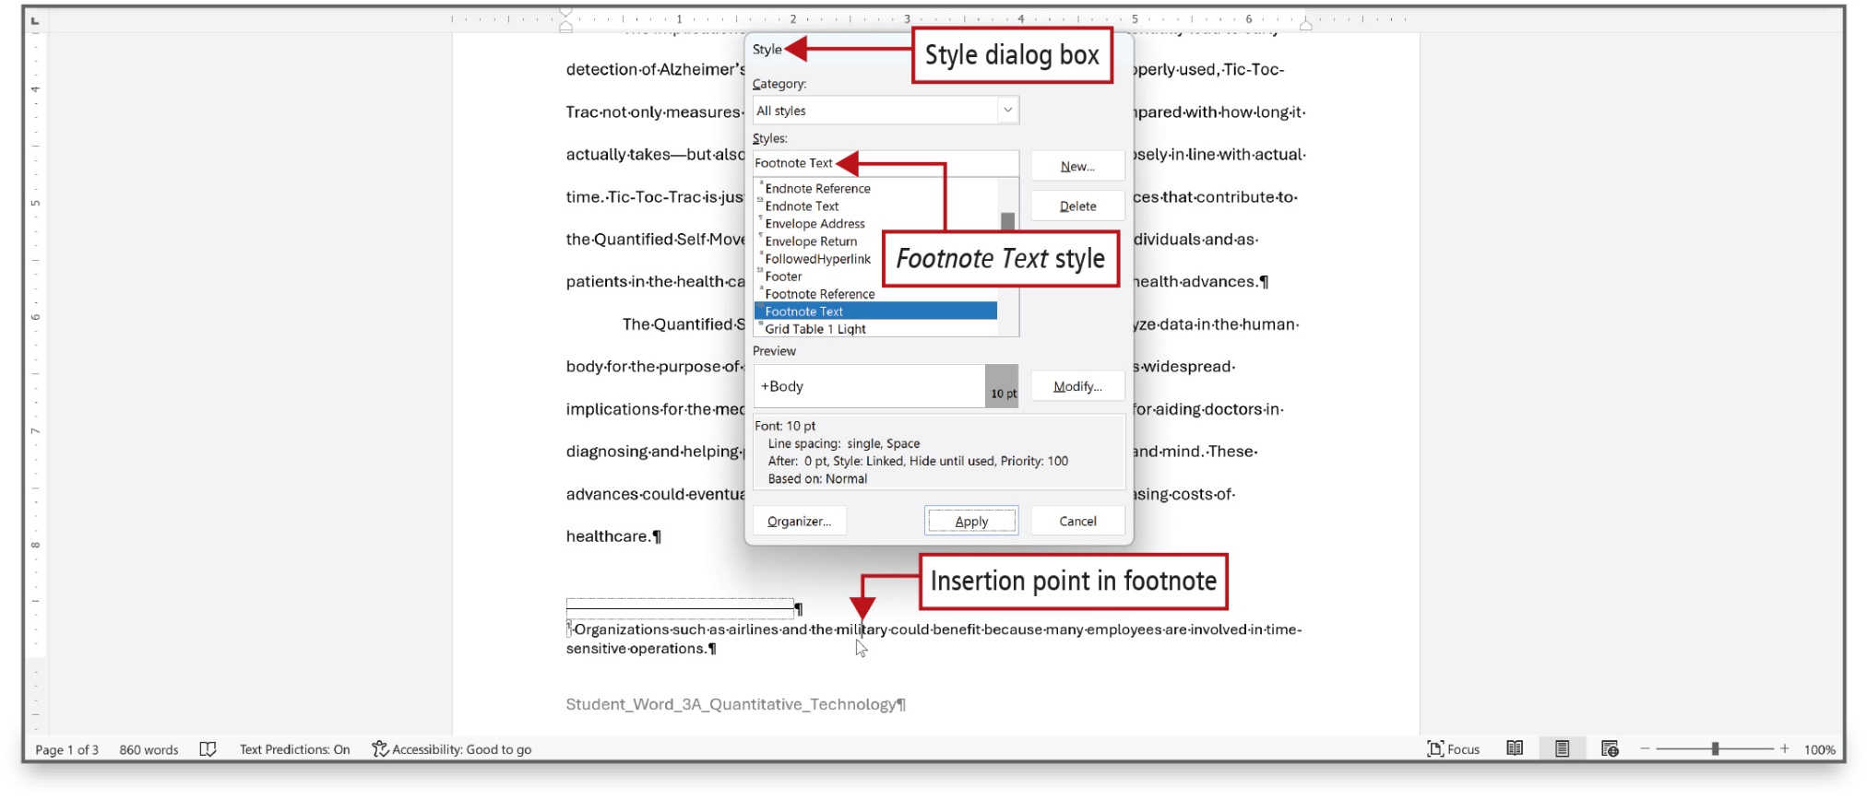
Figure 3.7
Notes:
Word contains built-in paragraph formats called styles—groups of formatting commands, such as font, font size, font color, paragraph alignment, and line spacing—that can be applied to a paragraph with one command. The default style for footnote text is single-spacing, 10-point Calibri font, and no paragraph indents. Word offers symbols, as well, instead of using numbers to designate footnotes. The Style dialog box is used to make changes.
Long Description:
The first annotation, insertion point in footnote, points to a word in the footnote in the footer. The Style dialog box pops up with category at the top, styles below the category, and preview below the styles. The second annotation, Style dialog box, points to Style (title) in the dialog box. The third annotation, Footnote Text style, points to Footnote Text selected under Styles in the dialog box.

Slide 9
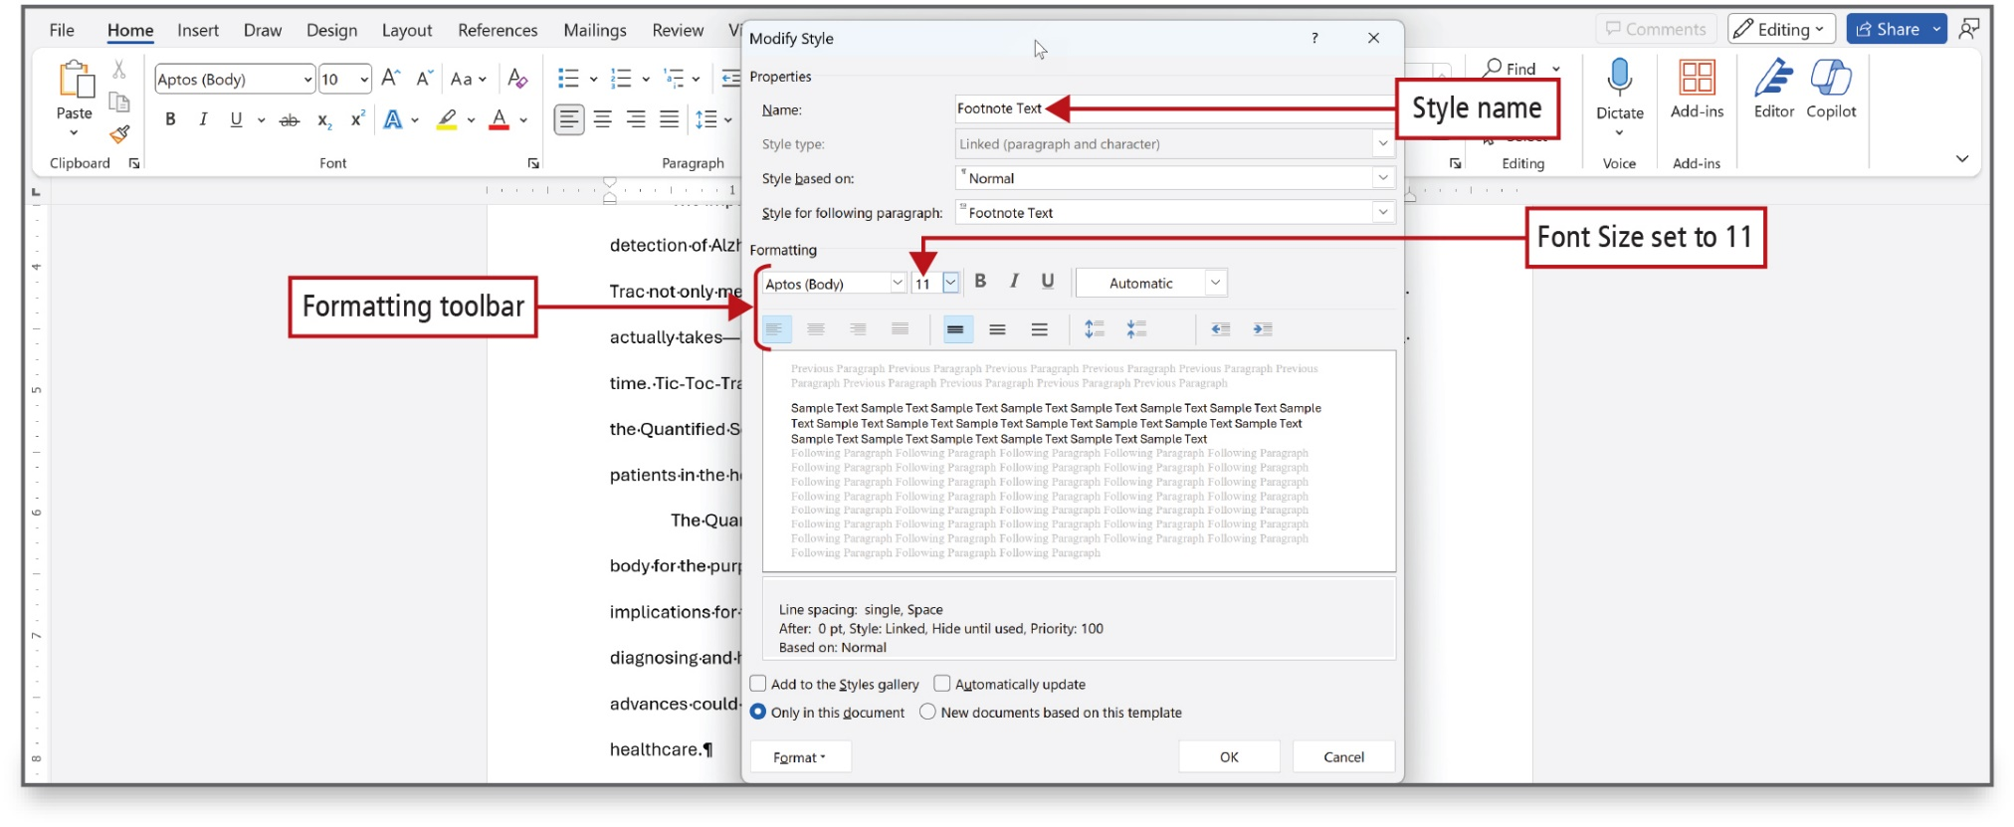
Figure 3.8
Notes:
The Modify Style dialog box is used to customize a style.
Long Description:
The dialog box shows two sections: Properties and Formatting. The Properties section shows the Name text box and dropdowns for Style based on and Style for following paragraph. The Formatting section shows font, alignment, and line spacing settings. The first annotation, style name, points to the Name text box set to Footnote Text. The second annotation, formatting tool bar, points to font name, font size, bold, italics, underlined, a drop-down menu in which automatic is selected, text alignments, and line spacing, of the dialog box. The third annotation, font size set to 11, points to 11 selected under font size of the dialog box.

Slide 10
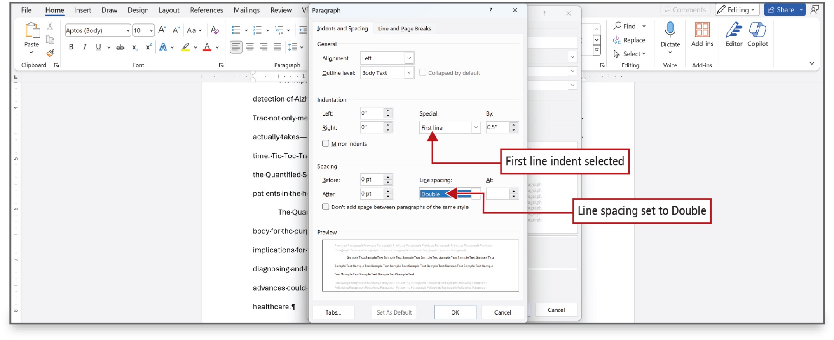
Figure 3.9
Notes:
The Paragraph dialog box is used to select paragraph options.
Long Description:
The dialog box shows two tabs: Indents and Spacing (selected) and Line and Page Breaks. There are four sections: General, Indentation, Spacing, and Preview. The General section shows the fields Alignment and Outline Level. The Indentation section shows the fields Left, Right, Special, and By. The Spacing section shows the fields Before, After, Line spacing, and At. The first annotation, first line indent selected, points to first line selected under special indentation of the dialog box. The second annotation, line spacing set to double, points to double selected under line spacing of the dialog box.

Slide 11
Create Citations and a Bibliography in a Research Paper (1 of 2)
Citation—note inserted into the text of a report or research paper that refers the reader to a source in the bibliography
Bibliography—list at the end of a research paper containing the sources to which you have referred—or cited
This list is typically titled Works Cited (in M L A style), Bibliography, Sources, or References
Notes:
Reports and research papers typically include information that is found in other sources, and these sources of information must be credited. When using quotations from or detailed summaries of other people’s work, you must specify the source of the information.
A citation is a note inserted into the text of a report or research paper that refers the reader to a source in the bibliography.
A bibliography is a list at the end of a research paper containing the sources to which you have referred—or cited.
This list is typically titled Works Cited (in M L A style), Bibliography, Sources, or References.

Slide 12
Create Citations and a Bibliography in a Research Paper (2 of 2)
Author: | Sopol, Eric J.
Title: | The Creative Destruction of Medicine
Year: | 2023
City: | New York
Publisher: | Basic Books
Medium | Print
Notes:
The information in the following table is entered in the next slide.

Slide 13
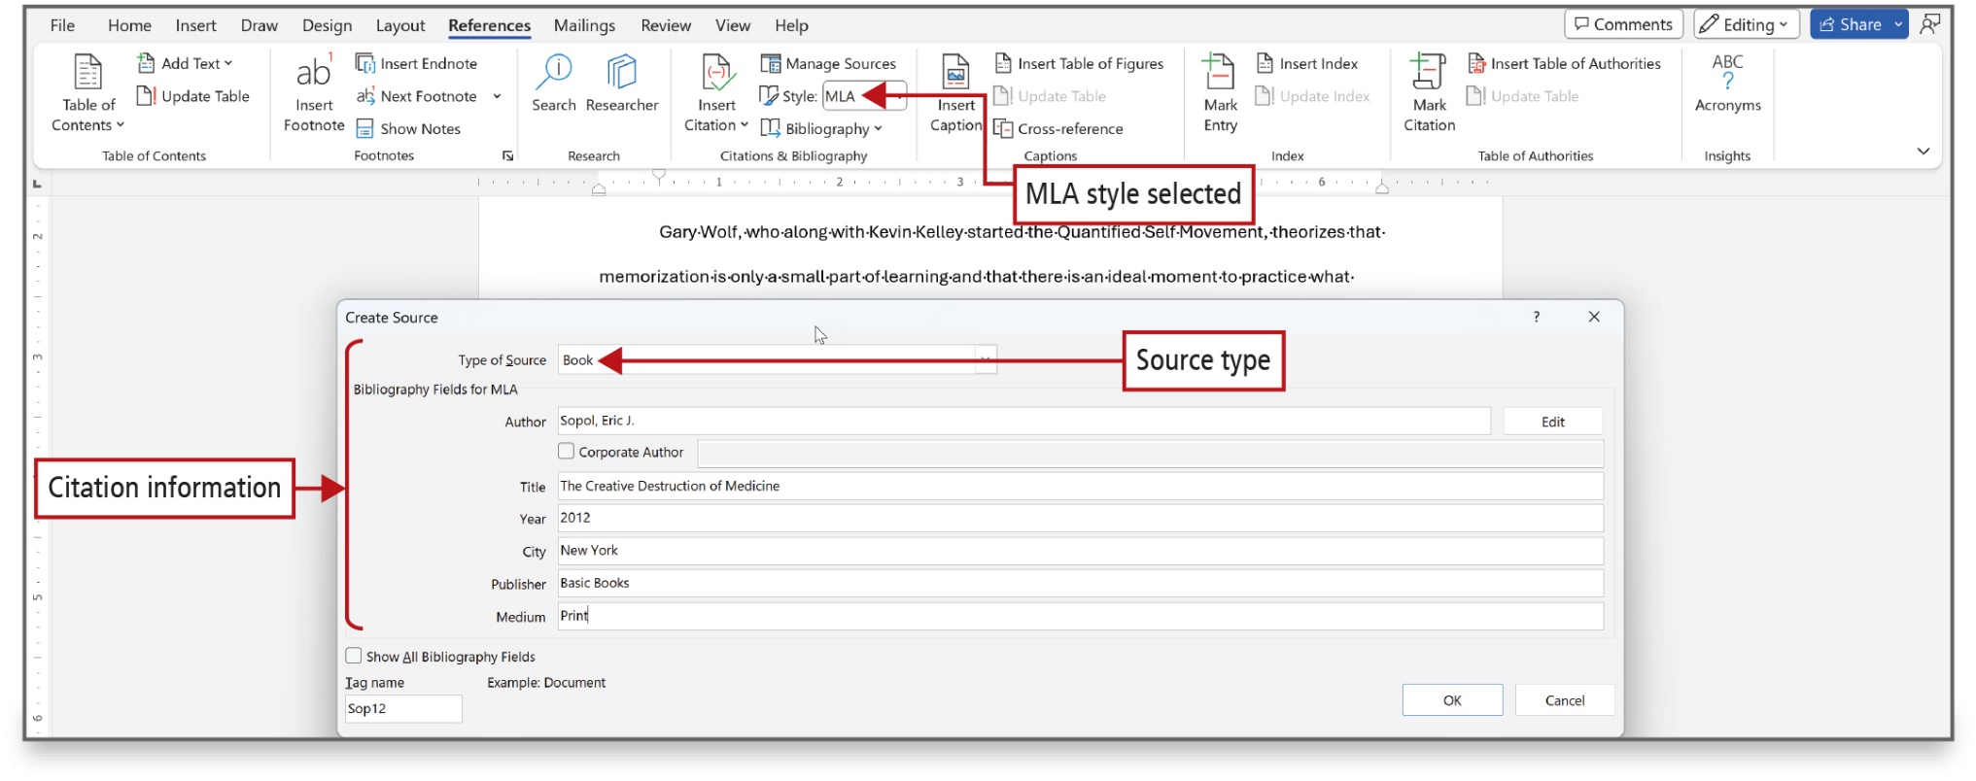
Figure 3.11
Notes:
The information from the previous slide is entered using the Create Source dialog box.
Long Description:
The first annotation, M L A Style selected, points to M L A selected under style in the Citations and Bibliography group of the ribbon. The Create Source dialog box pops up. The second annotation, source type, points to book selected under type of source in the dialog box. The third annotation, citation information, points to the following in the dialog box: Type of Source, Bibliography fields for M L A: Author, Title, Year, City, Publisher, and Medium.

Slide 14
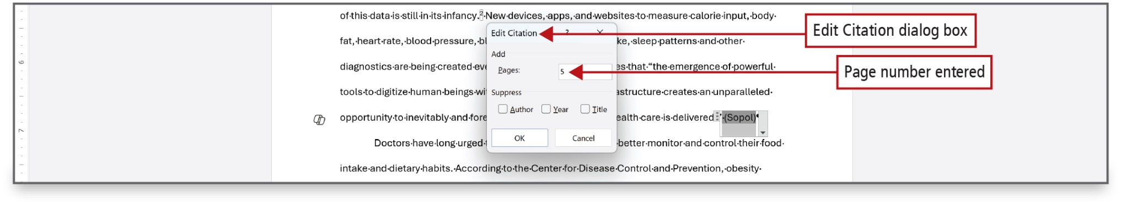
Figure 3.12
Notes:
Changes to a citation are made using the Edit Citation dialog box.
Long Description:
The highlighted word Sopol has a dropdown-like arrow and the three dots icon on its left. The Edit Citation dialog box shows the Pages text box in the Add section and check boxes for Author, Year, and Title in the Suppress section. The first annotation, Edit Citation dialog box, points to Edit Citation (title) of the dialog box. The second annotation, Page number entered, points to 5 selected under the Pages text box in the Add section of the dialog box.

Slide 15
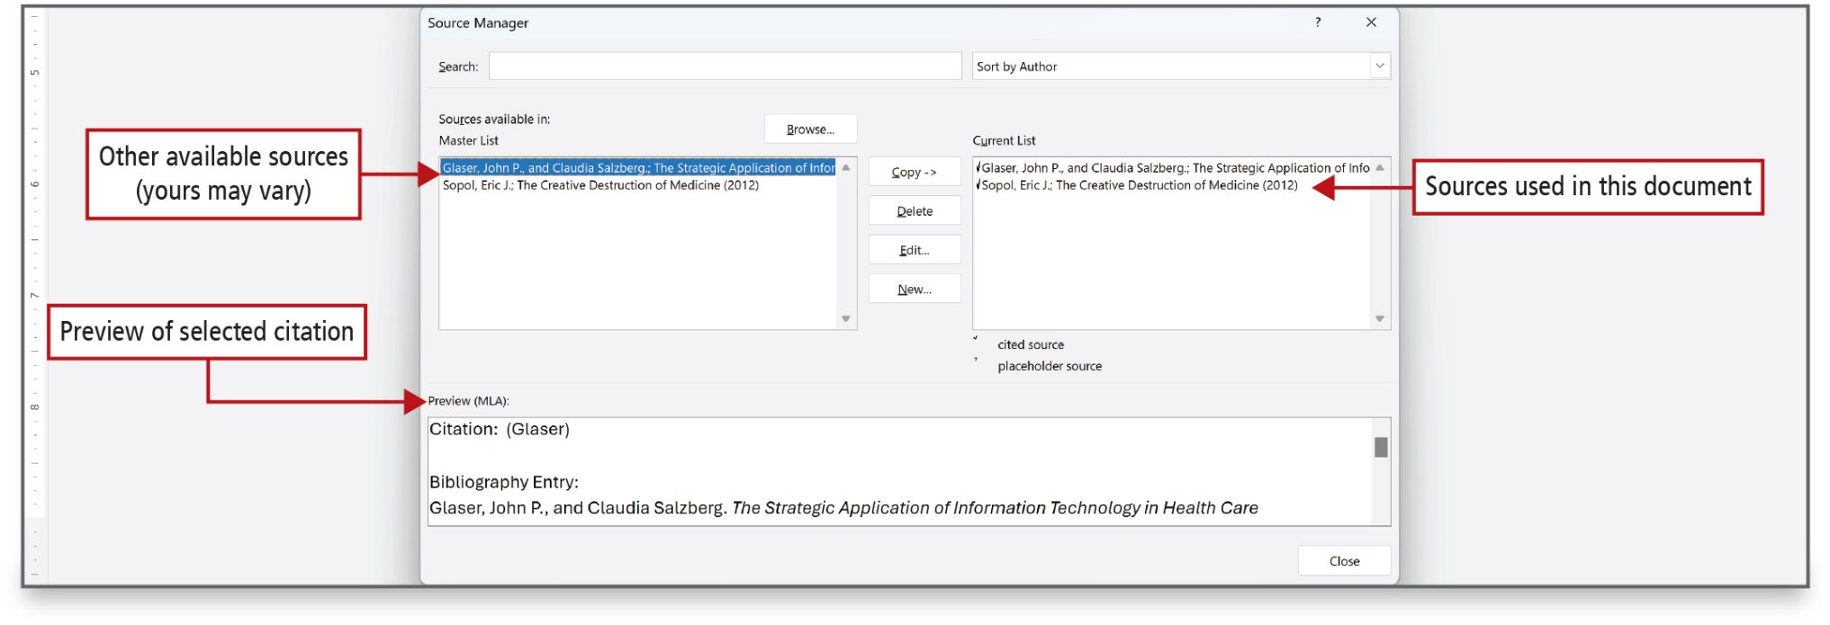
Figure 3.13
Notes:
The Source Manager dialog box displays the Master List box and the citations for the current document display in the Current List box. Word maintains the Master List so that if you use the same sources regularly, you can copy sources from your Master List to the current document.
Long Description:
The Source Manager dialog box shows the Search box with a dropdown, the section Sources available in with a Browse button, the list boxes Master List on the left and Current List on the right, and the Preview (M L A) text box. There are three annotations. The first annotation, other available sources (yours may vary), points to Glaser, John P., and Claudia Salzberg: The Strategic Application of Info selected under Master List of the dialog box. The second annotation, sources used in this document, points to Glaser, John P., and Claudia Salzberg: The Strategic Application of Info and Sopol Eric J: The Creative Destruction of Medicine (2012) under Current List of the dialog box. The third annotation, Preview of selected citation, points to preview (M L A) at the bottom of the dialog box.

Slide 16
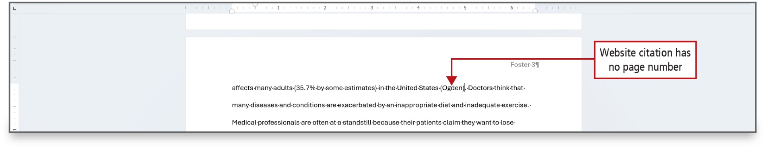
Figure 3.14
Notes:
A parenthetical reference is a reference that includes the last name of the author or authors and the page number (if available) in the references source, which you add to the reference. No year is indicated, and there is no comma between the name and the page number. Most Website citations, as shown on this slide, do not include a page number.

Slide 17
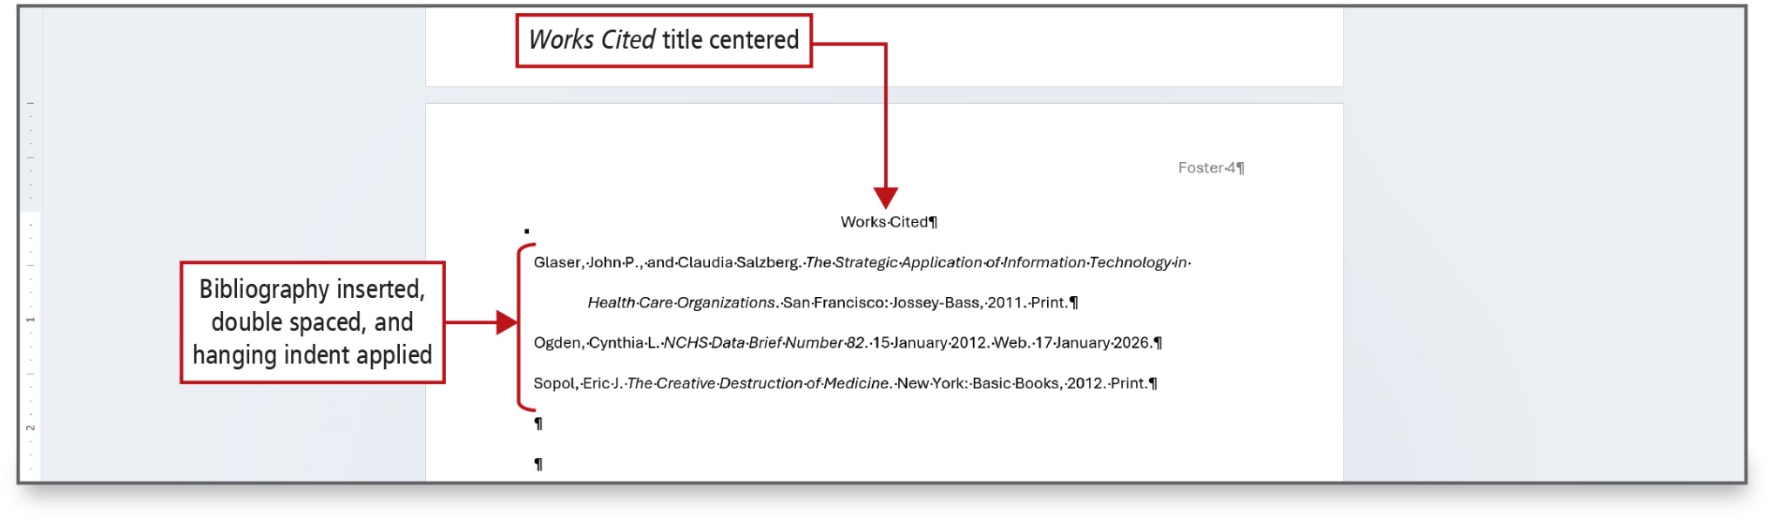
Figure 3.16
Notes:
At the end of a report or research paper, include a list of each source referenced. Works Cited is the reference page heading used in the M L A style guidelines. Other styles may refer to this page as a Bibliography (Business Style) or References (A P A Style). Always display this information on a separate page. You can press C t r l + Enter to insert a manual page break—to force a new page. Note the hanging indent, where the first line of each entry extends .5 inches to the left of the remaining lines of the entry.
Long Description:
The first annotation, Works Cited title centered, points to the title: Works Cited, at the top center of page 4 in the report. The second annotation, Bibliography inserted, double spaced, and hanging indent applied, points to the three works cited below the Works Cited title.

Slide 18
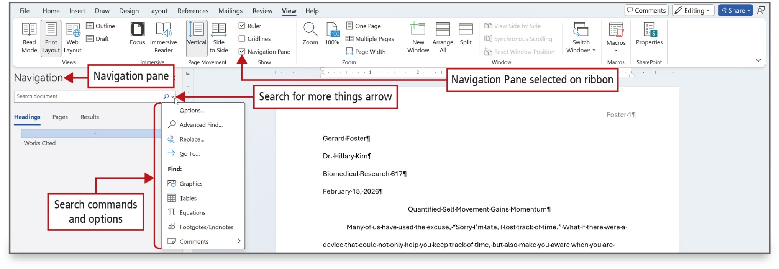
Figure 3.18
Notes:
The Navigation pane makes it easy to move to a specific page or to find specific objects in a document. To use the Go To command, use the Home tab and click Go To from the Find arrow or press Ctrl + G.
Long Description:
The Print Layout button from the Views group, the Vertical button from the Page Movement group, and the Navigation pane check box from the Show group are selected from the ribbon. The first annotation, Navigation Pane selected on ribbon, points to the selected checkbox for Navigation Pane in the Show group of the ribbon. The Navigation pane opens on the left of the report with a search bar that has a dropdown arrow on its right. The pane shows three tabs: Headings, Pages, and Results. The second annotation, Navigation Pane, points to the title: Navigation at the top of the pane. The third annotation, search for more things arrow, points to the dropdown arrow on the right of the search bar in the navigation pane. A menu with the following options opens up on clicking the dropdown arrow: Options, Advanced find, Replace, Go to, Find: Graphics, Tables, Equations, Footnotes or Endnotes, and Comments. The fourth annotation, search commands and options, points to the menu.

Slide 19
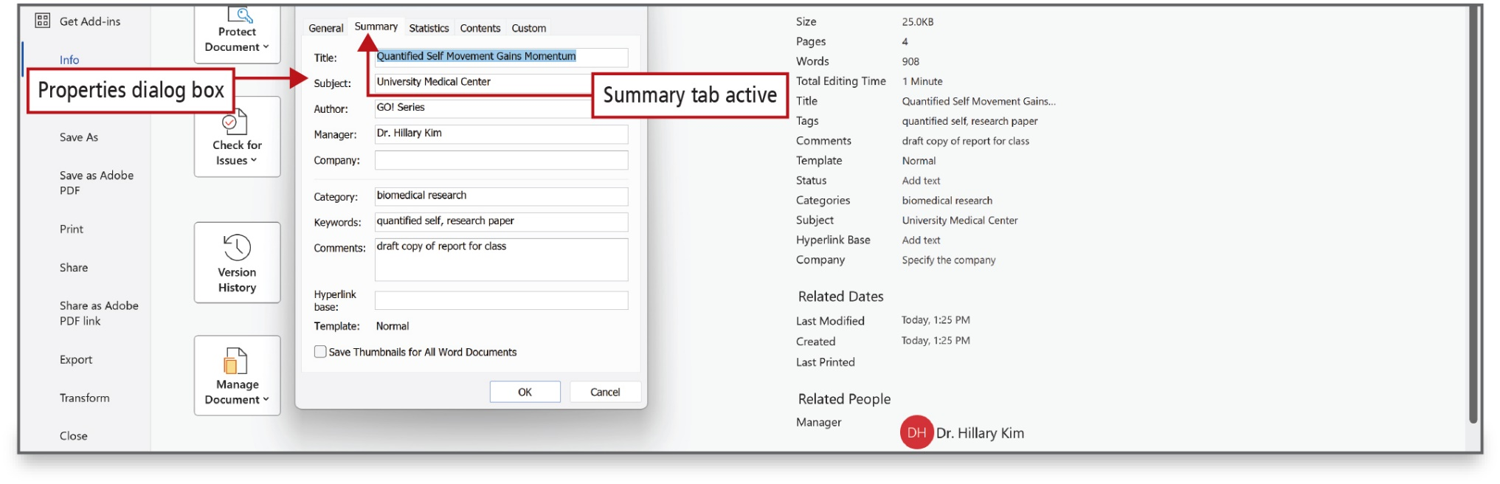
Figure 3.19
Notes:
For a research paper, you may want to add additional document properties. In the Advanced Properties dialog box, you can view and modify additional document properties as shown here.
Long Description:
The properties dialog box is open with the following tabs: General, Summary (selected), Statistics, Contents, and Custom. The first annotation, Properties dialog box, points to the dialog box. The Summary tab shows Title, Subject, Author, Manager, Company, Category, Keywords, Comments, Hyperlink Base, and Template. The second annotation, Summary tab active, points to the summary tab in the dialog box. The properties of the document along with related dates and related people are shown on the right.

Slide 20
Use Research Tools, Use Read Mode, and Save Documents in Alternate Formats
Search—Research command used to search for definitions, images, web pages, and other results from various online sources
Reasearcher—Research command that helps find quotes, citable sources, and images for a research paper
Text Highlight Color—Word command that is used to apply a highlight color to selected text
Read Mode—optimizes the view of the Word screen for the times when you are reading Word document on the screen and not creating or editing them
Notes:
Search is a Research command used to search for definitions, images, web pages, and other results from various online sources without leaving the Word document.
Researcher is a Research command that helps find quotes, citable sources, and images for a research paper. For sources that are selected, citation information is available.
Text Highlight Color is a Word command that is used to apply a highlight color to selected text
Read Mode optimizes the view of the Word screen for the times when you are reading Word document on the screen and not creating or editing them. On the View tab, in the Views group, click Read Mode. Read Mode keeps footnotes displayed on the page associated with the footnote

Slide 21
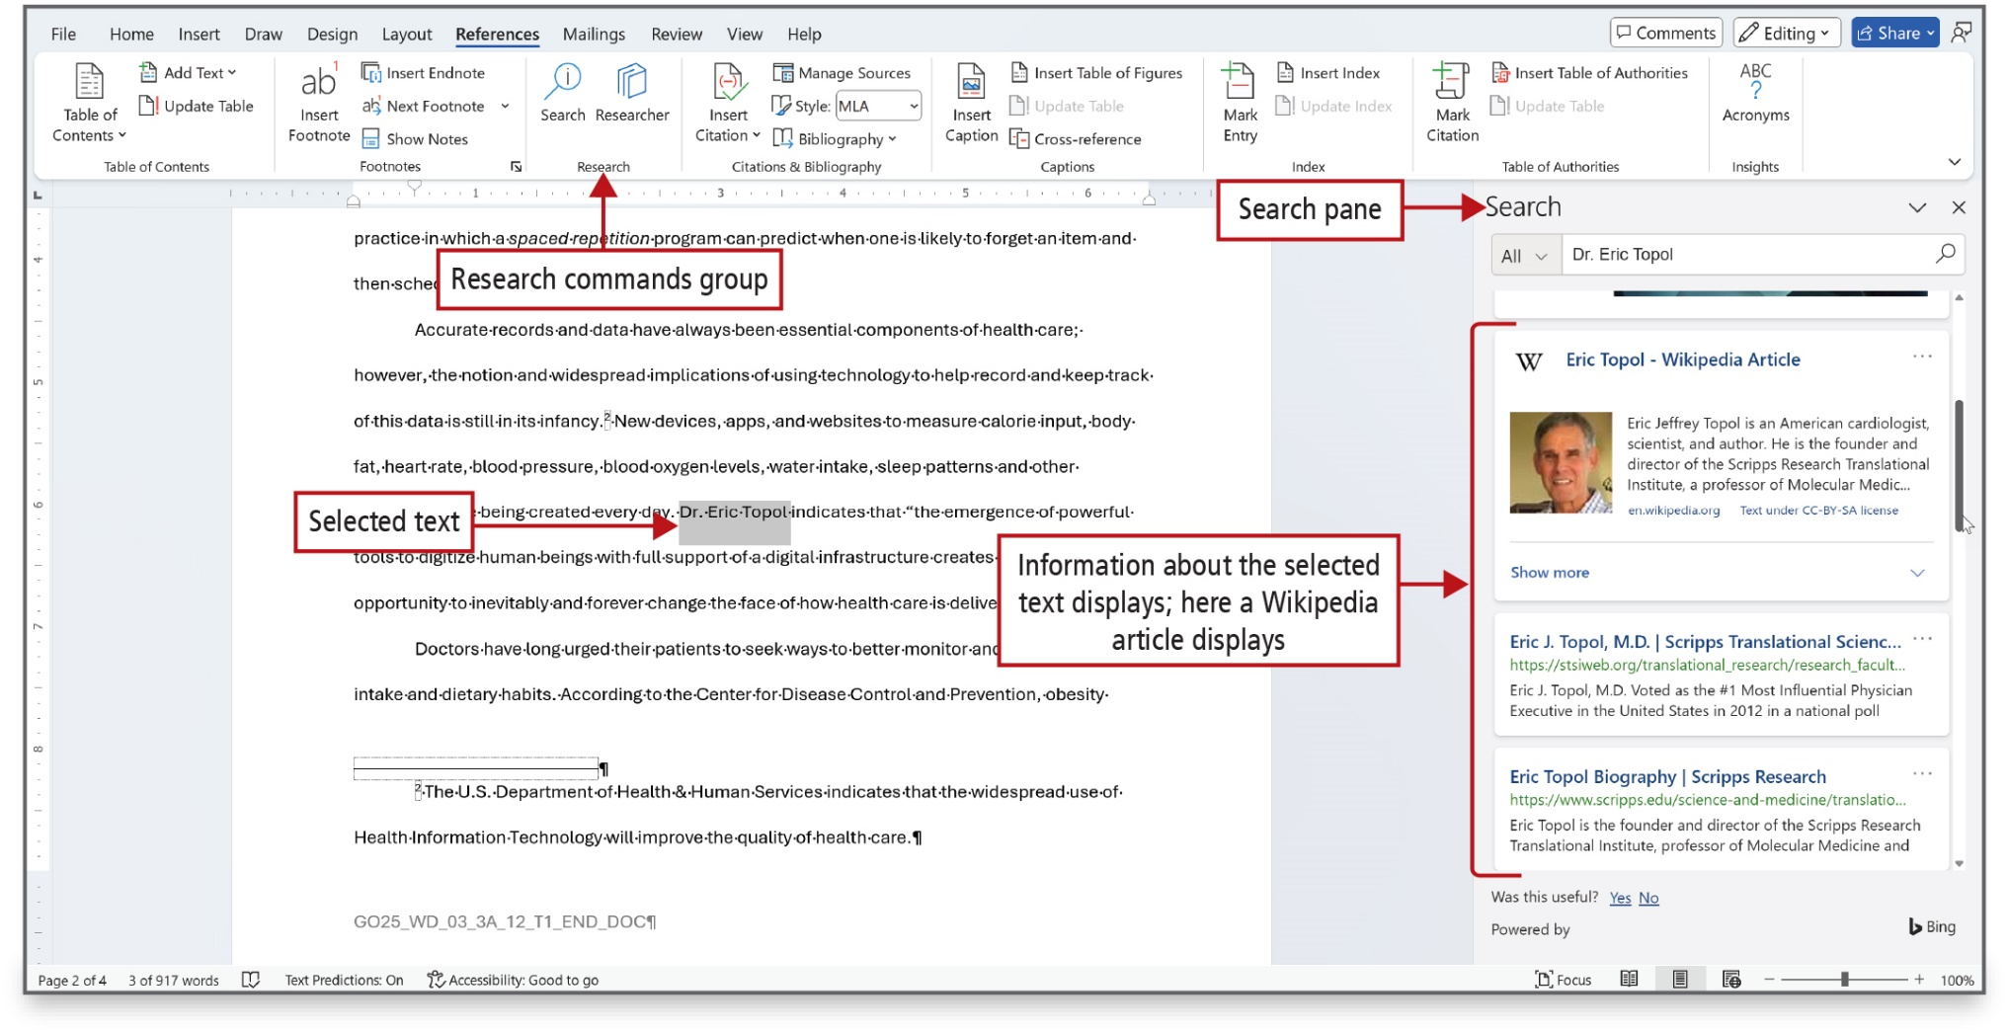
Figure 3.20
Notes:
Search is a Word feature that can be used to get information about selected text. Search can show definitions, images, and results from various online sources.
Long Description;
There are four annotations. The first annotation on the center, Research commands group, points to the Research group under the References tab. The second annotation, Selected Text, points to the text Dr. Eric Topol in the report. The Search pane with a search bar and results below opens on the right. The third annotation, Search Pane, points to title: Search in the Search pane. The fourth annotation, Information about the selected text displays: here a Wikipedia article displays, points to the search results in the Search pane.

Slide 22
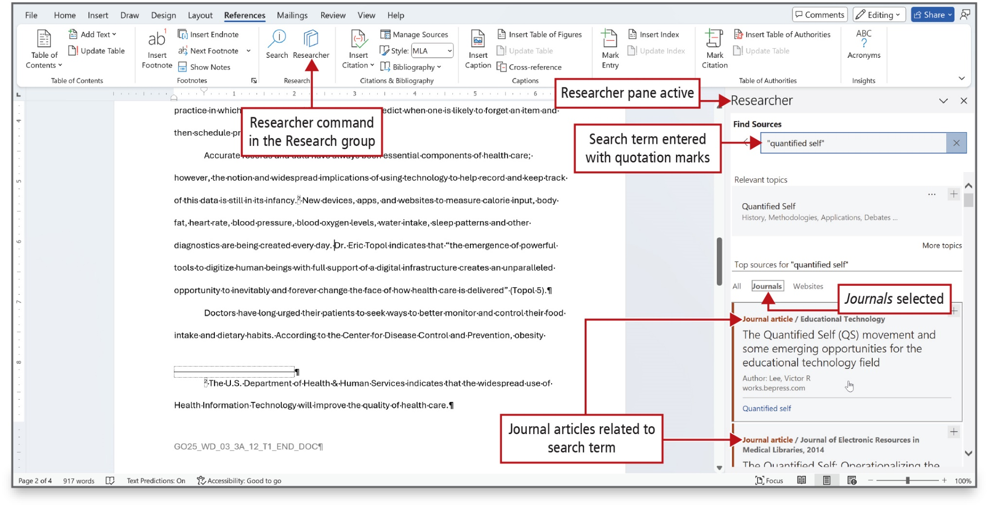
Figure 3.21
Notes:
Researcher is a Word feature that helps you find topics and reliable sources for a research paper. For selected source, citation information is available.
Long Description:
There are four annotations. The first annotation on the center, Researcher command in the Researcher group, points to the Research group under the References tab. The Researcher pane shows the section Find Sources with a search bar with a close button, the section Relevant topics displaying topics that are relevant to the search term, and the section Top sources for the search term in quotes shows the All, Journals, and Websites tabs. The Journals displays a list of journals below. The second annotation, Researcher pane active, points to title: Researcher in the researcher pane. The third annotation, Search item entered with quotation marks, points to the words in the search bar of the researcher pane. The fourth annotation, Journals selected, points to the Journals tab selected in the Researcher pane. The fifth annotation, Journal articles related to search term, points to the search results under the Journals tab.

Slide 23
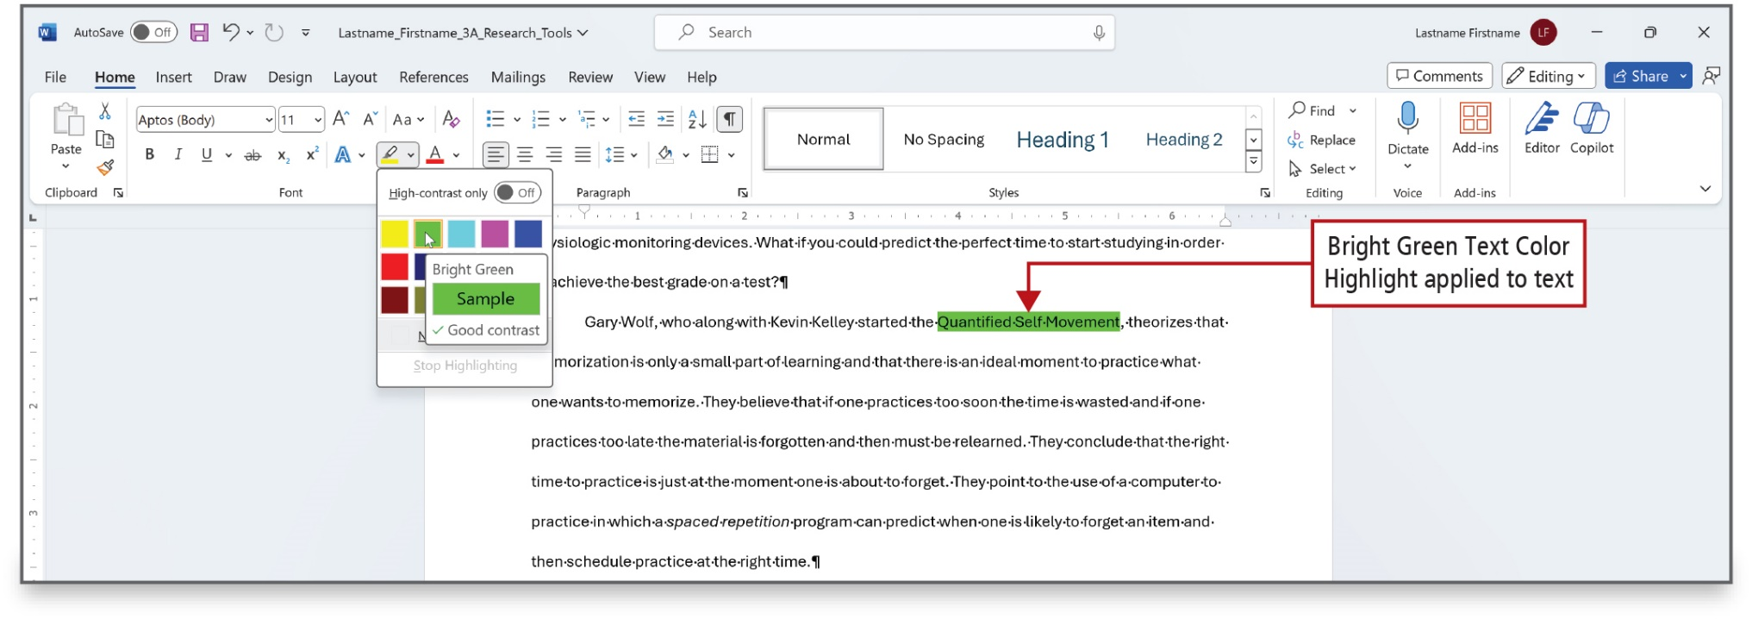
Figure 3.22
Notes:
Text Highlight Color is a Word command with which you can apply a highlight color to selected text.
Long Description:
The Text Color Highlight button displayed as a paint brush icon in the Font group shows bright green selected. A pop-up for the selected color shows Sample (selected) and Good contrast. An annotation, Bright green text color highlight applied to text, points to the phrase selected in the report.

Slide 24
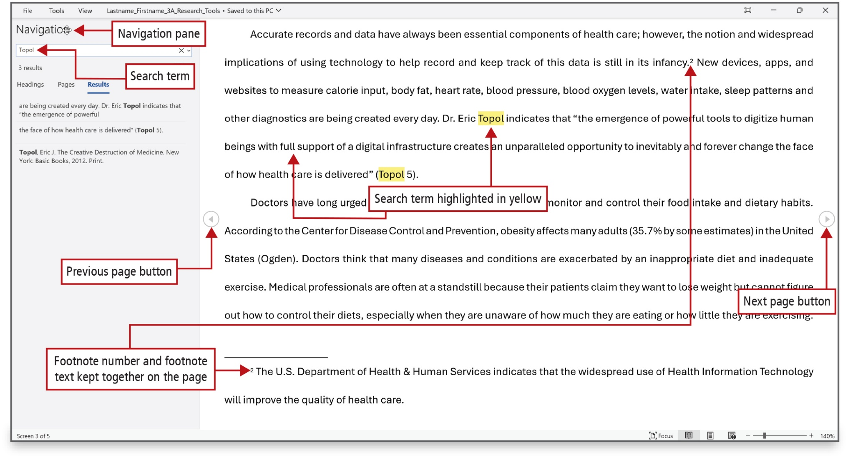
Figure 3.23
Notes:
In the Search box, enter the word to search for. Notice that Word displays the first page where the search term displays and highlights the term in yellow.
Long Description:
The document has a left arrow button (previous page button) and a right arrow button (next page button) to the left and right of the report, respectively. The search term in two instances is highlighted in yellow. The first annotation at the center, search item highlighted in yellow, points to the terms (Topol) in the report. The second annotation, previous page button, points to the left arrow button. The third annotation, next page button, points to the right arrow button. The navigation pane with a search bar with text Topol opens up on the left side of the report. The search results are displayed under the Results tab. The fourth annotation, Navigation pane, points to the title: Navigation in the navigation pane. The fifth annotation, search item, points to the search bar in the navigation pane. The sixth annotation, footnote number and footnote text kept together on the page, points to the superscript 2 near a word, infancy, and the footnote that has the reference for superscript 2 at the bottom.

Slide 25
Figure 3.24 (1 of 2)
View Commands in Read Mode
View Command | Action
Edit Document | Return to Print Layout view to continue editing the document.
Focus | Eliminate distractions to focus on the document.
Navigation Pane | Search for specific text or click a heading or page to move to the location.
Show Comments | See comments, if any, within the document.
Column Width | Change the display of the document to fit more or less text on each line.
Page Color | Change the colors used to show the document to make it easier to read. Some readers prefer a sepia (brownish-gray) shading as the background or a black background with white text.
Notes:
This table shows additional View commands in Read Mode.

Slide 26
Figure 3.24 (2 of 2)
View Commands in Read Mode
View Command | Action
Layout | Read in different layouts. Select Column Layout, which is the default, or Paper Layout, which mimics the 8.5 by 11 format but without the ribbon.
A-Z Syllables | Show the breaks between the syllables.
A-Z Text Spacing | Increase spacing between words, characters, and lines.
Read Aloud | Read text out loud and highlight each word as it is read.
Notes:
This table shows additional View commands in Read Mode.

Slide 27
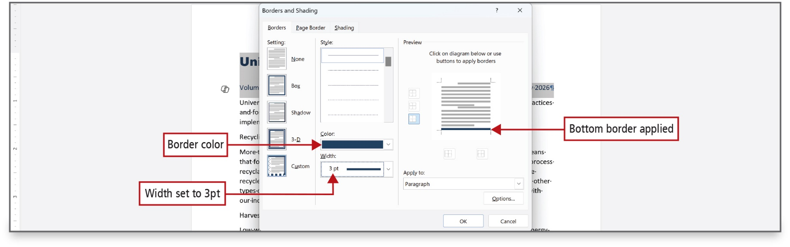
Figure 3.26
Notes:
This figure shows the Borders and Shading dialog box, from which border options are selected.
Long Description:
The Borders and Shading dialog box shows three tabs (Borders, Page Border, and Shading) in which the Borders tab is selected. The Borders tab shows five different settings (None, Box, Shadow, 3-D, and Custom) in the Setting section, five different styles, the Color dropdown, and the Width dropdown in the Style section, and a preview of the border style and the Apply to dropdown menu in which paragraph is selected in the Preview section. The first annotation, Border color, points to the color selected in the Color dropdown. The second annotation, Width set to 3 p t, points to 3 p t selected in the Width dropdown. The third annotation, Bottom border applied, points to the bottom border shown in the preview of the dialog box.

Slide 28
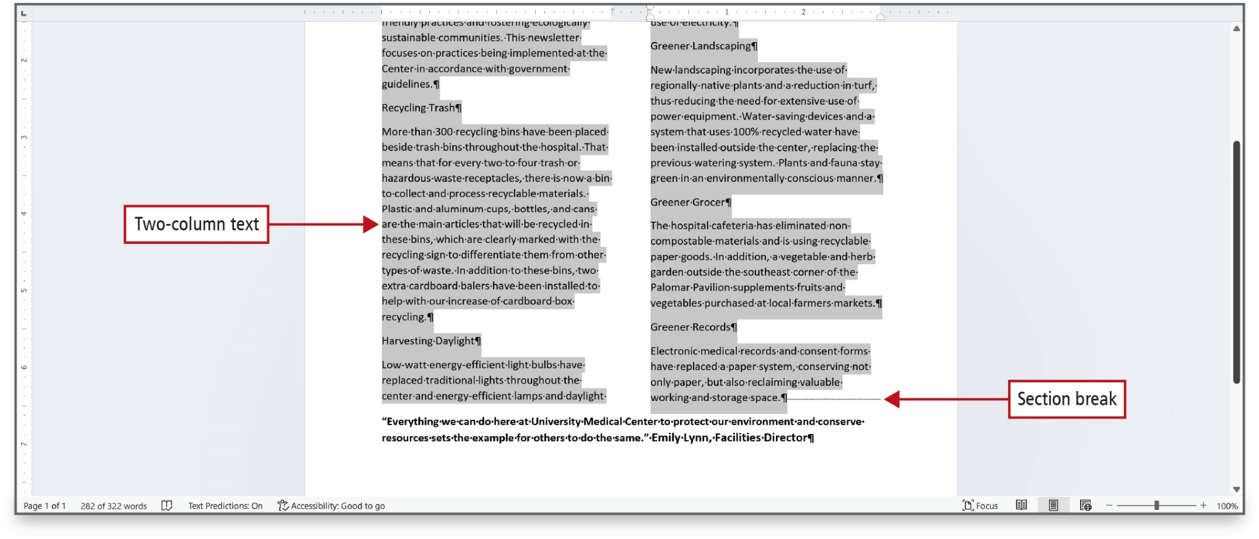
Figure 3.28
Notes:
A newsletter is a periodical that communicates news and information to a specific group. Newsletters often have two or more columns. A manual column break is an artificial end to a column to balance the columns or to provide space for the insertion of other objects. A section is a portion of a document that can be formatted differently from the rest of the document. A section break at the end of the selection, divides the one column
section of the document from the two-column section of the document.
Long Description:
The text in the two columns are selected. The first callout, two-column text, points to the text in the two columns of the report. A small horizontal fluctuating line is shown after the text in the second column. The second callout, section break, points to the small horizontal fluctuating line in the report.

Slide 29
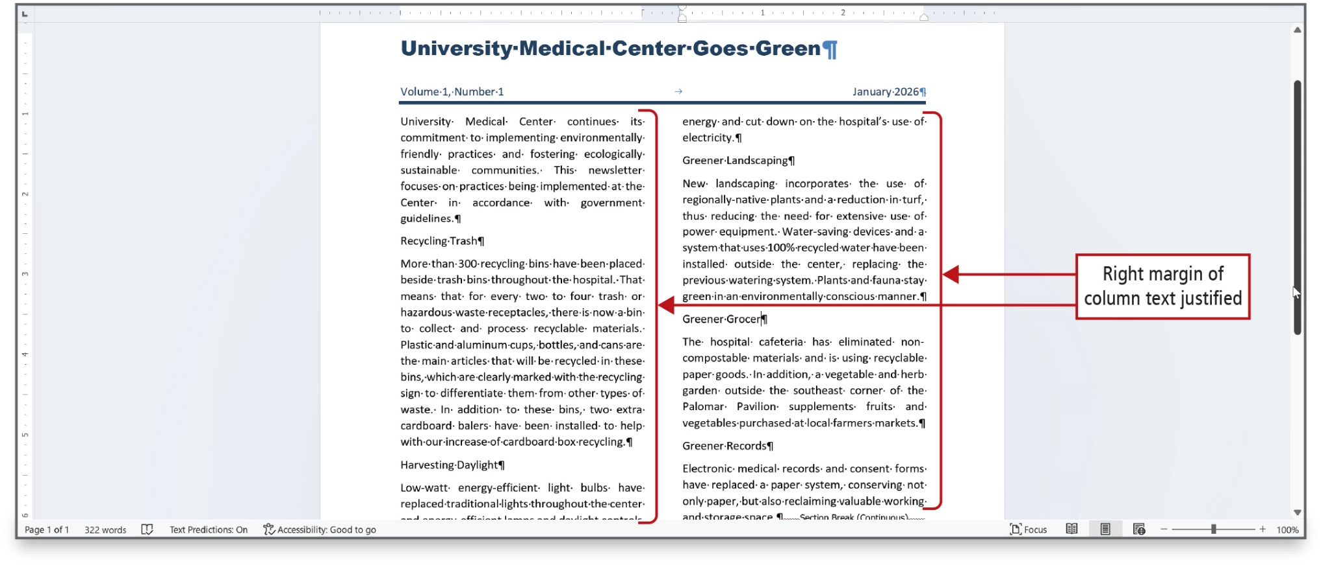
Figure 3.29
Notes:
Justified text is sometimes preferred in document text with two or more columns. It is often considered easier to read than having an uneven right margin.

Slide 30
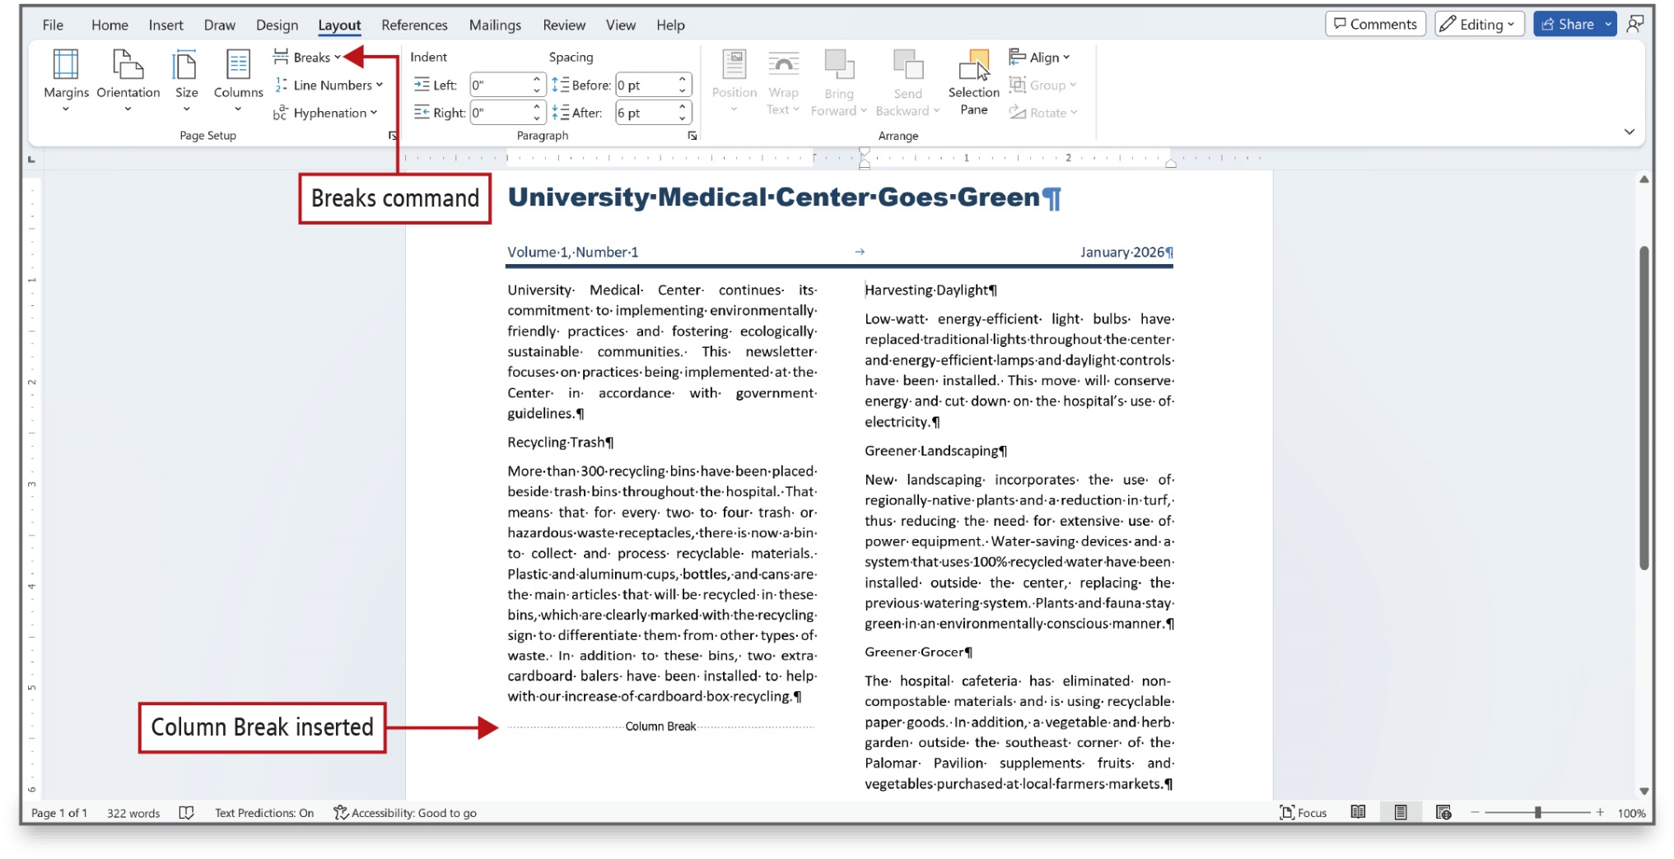
Figure 3.30
Notes:
A column break indicator is a dotted line containing the words Column Break that displays at the bottom of a column.
Long Description:
The Breaks command is shown in the Page Setup group of the ribbon. The first annotation, Breaks command, points to the Breaks button in the ribbon. A horizontal dotted line with text: Column Break in the center is shown below the text in the first column. The second annotation, column break inserted, points to the horizontal dotted line.

Slide 31
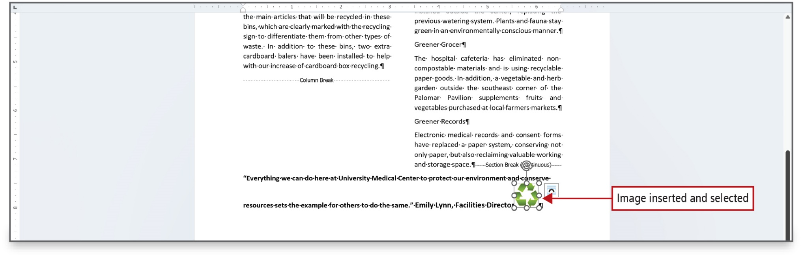
Figure 3.31
Notes:
Pictures can make a newsletter visually appealing and more interesting.

Slide 32
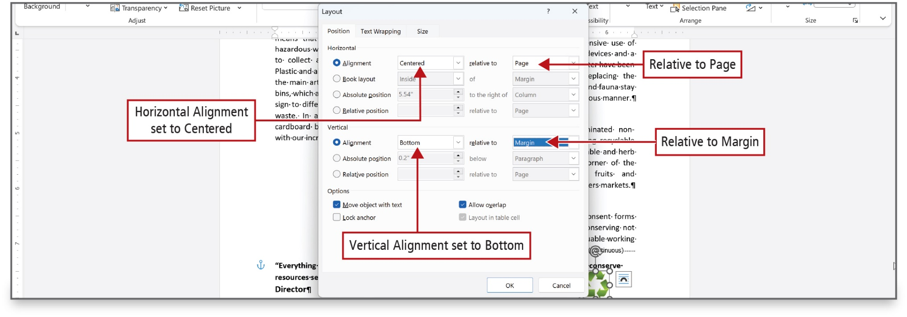
Figure 3.33
Notes:
Once an image has been inserted, the Layout dialog box can be used to change the horizontal and vertical alignment.
Long Description:
The Layout dialog box shows three tabs: Position, Text Wrapping, and Size. The Position tab displays three sections: Horizontal, Vertical, and Options. In the Horizontal and Vertical sections, there are fields on the left and the relative fields on the right. The Horizontal section shows the following on the left: Alignment, Book layout, Absolute position, and Relative position and the following on the right: relative to, of, to the right of, and relative to. The Vertical shows the same left options except the removal of Book layout and the right options as relative to, below, and relative to. The Options section shows check boxes. The first annotation, horizontal alignment set to centered, points to centered selected in the Alignment dropdown under the Horizontal section in the dialog box. The second annotation, relative to page, points to Page selected in the relative to dropdown under the Horizontal section in the dialog box. The third annotation at the center, vertical alignment set to bottom, points to Bottom selected in the Alignment dropdown under the Vertical section in the dialog box. The fourth annotation, relative to Margin, points to Margin selected in the relative to dropdown under the Vertical section in the dialog box.

Slide 33
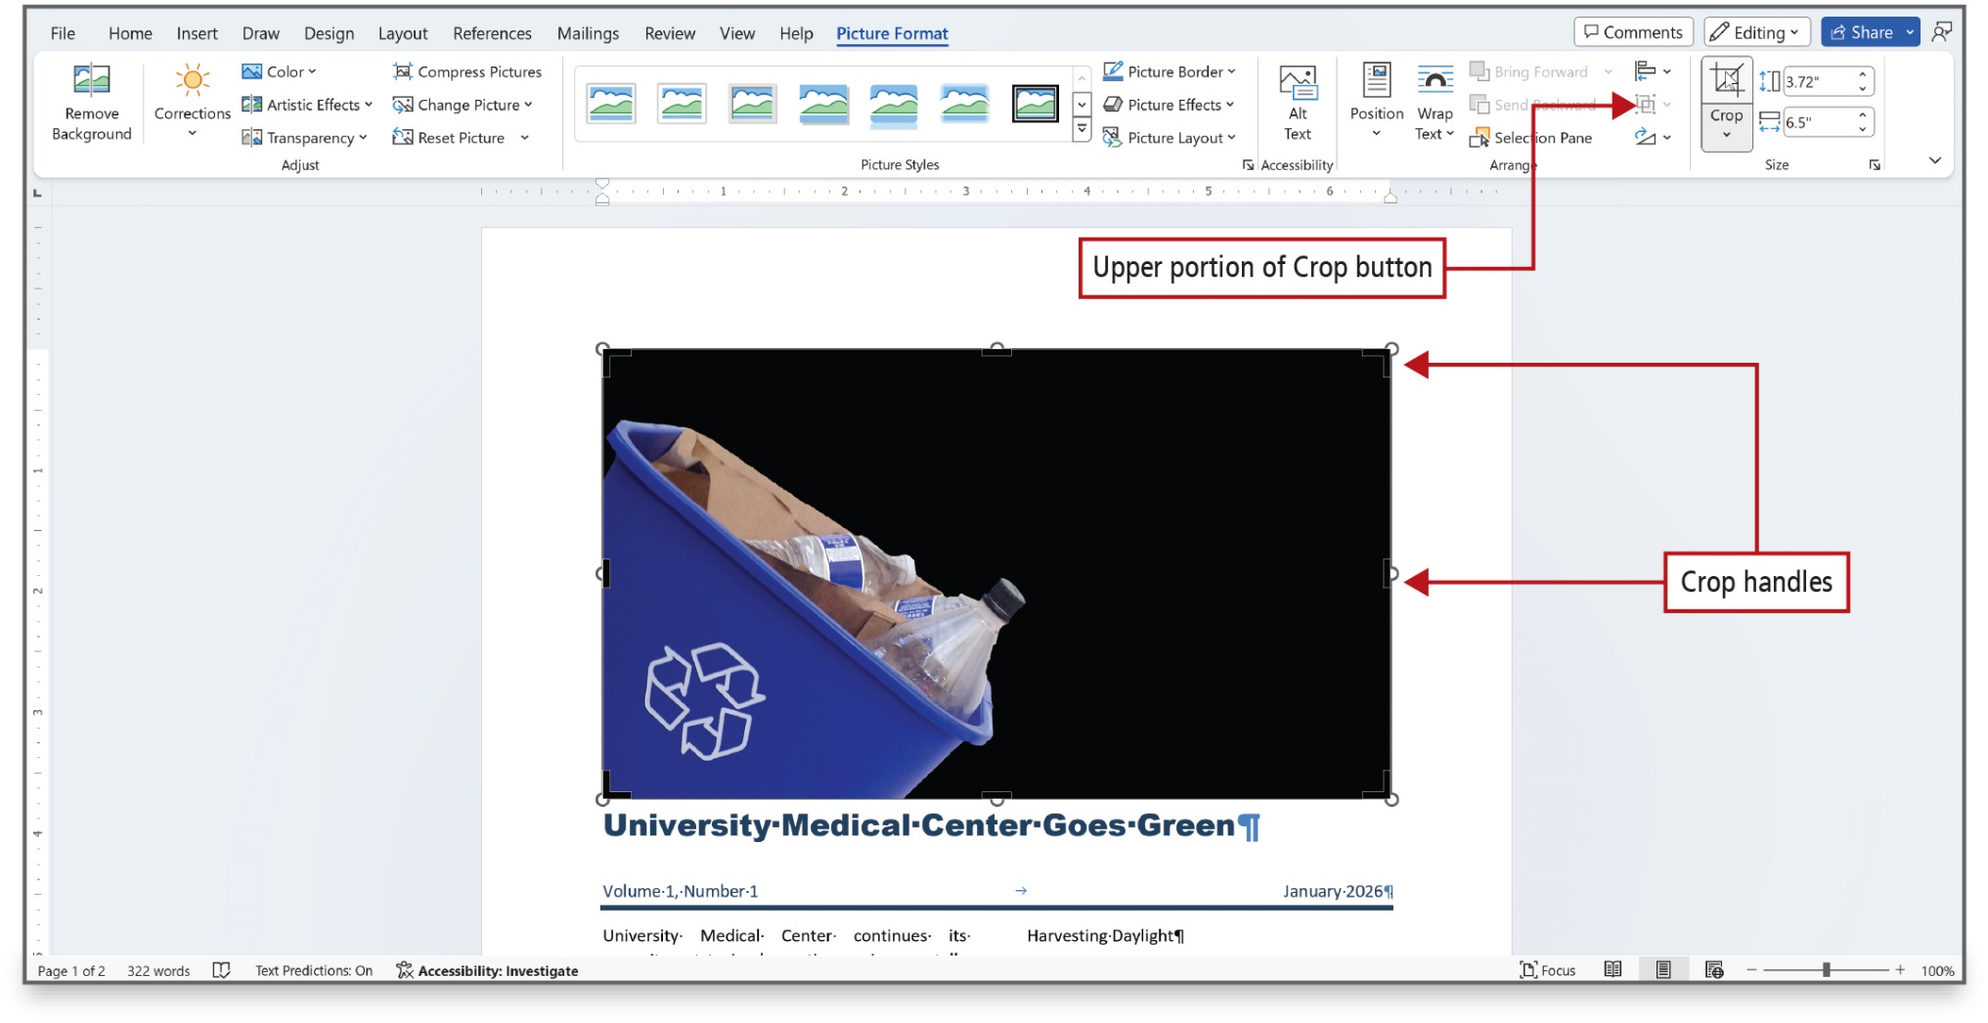
Figure 3.34
Notes:
An inserted image can be cropped—removing unwanted or unnecessary areas of a picture. When you scale a picture, you resize it to a percentage of its size. Crop handles are used like sizing handles to define unwanted areas of a picture, as shown on this slide.
Long Description:
A picture is inserted above the report title with circles at the four corners and midpoints of the four sides of the image. The Crop button in the Size group on the ribbon is selected. The first annotation, upper portion of Crop button, points to two overlapping squares button near the Crop button. The second annotation, upper portion of Crop button, points to the circles around the image.

Slide 34
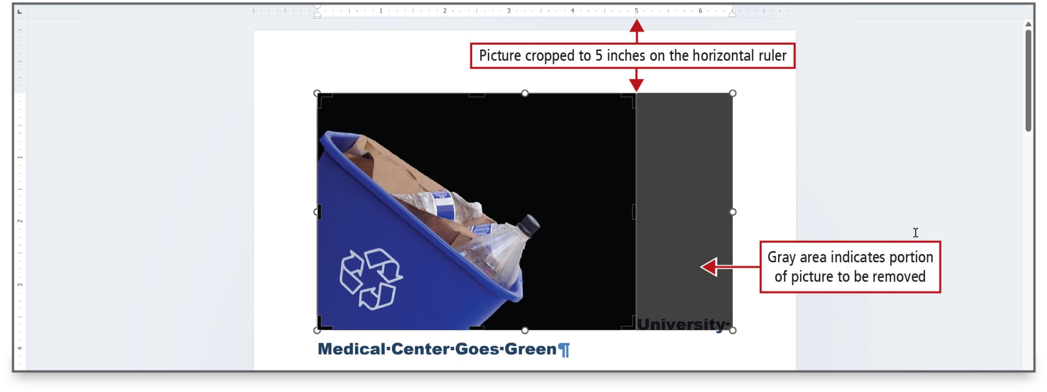
Figure 3.36
Notes:
The crop pointer is used to crop an image. The portion of the image to be removed displays in gray.
Long Description:
A ruler that ranges from 0 to 6.4 in increments of 0.2 is shown above the report. The first annotation at the center, picture cropped to 5 inches on the horizontal ruler, points to 5 on the ruler and its corresponding point on the image. The portion of the image to the right side of this marking is shaded in gray. The second annotation, gray area indicates portion of picture to be removed, points to the gray-shaded portion of the image.

Slide 35
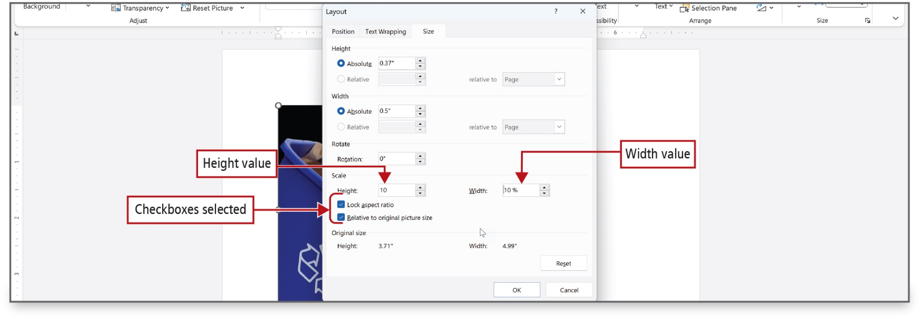
Figure 3.37
Notes:
When Lock aspect ratio is selected, the height and width of the picture are sized proportionately and only one scale value is necessary. The second value—in this instance Width—adjusts proportionately. When Relative to original picture size is selected, the scale is applied as a percentage of the original picture size.
Long Description:
The Layout dialog box shows three tabs: Position, Text Wrapping, and Size. The Size tab displays the following sections: Height, Width, Rotate, Scale, and Original size. The Height and Width sections show the fields Absolute, Relative, and relative to. The Rotate section shows the Rotation spin box. The Scale section shows the Height and Width spin boxes and check boxes below. The selected fields are as follows: In the Height section, Absolute is set to 0.37 inches. In the Width section, Absolute is set to 0.5 inches. In the Scale section, the check boxes Lock aspect ratio and Relative to original picture size are selected. The first annotation, height value, points to 10 selected in the Height dropdown under the Scale section in the dialog box. The second annotation, width value, points to 10 percent selected in the Width dropdown under the Scale section in the dialog box. The third annotation, checkboxes selected, points to the check boxes for Lock aspect ratio and Relative to original picture size under the Scale section.

Slide 36
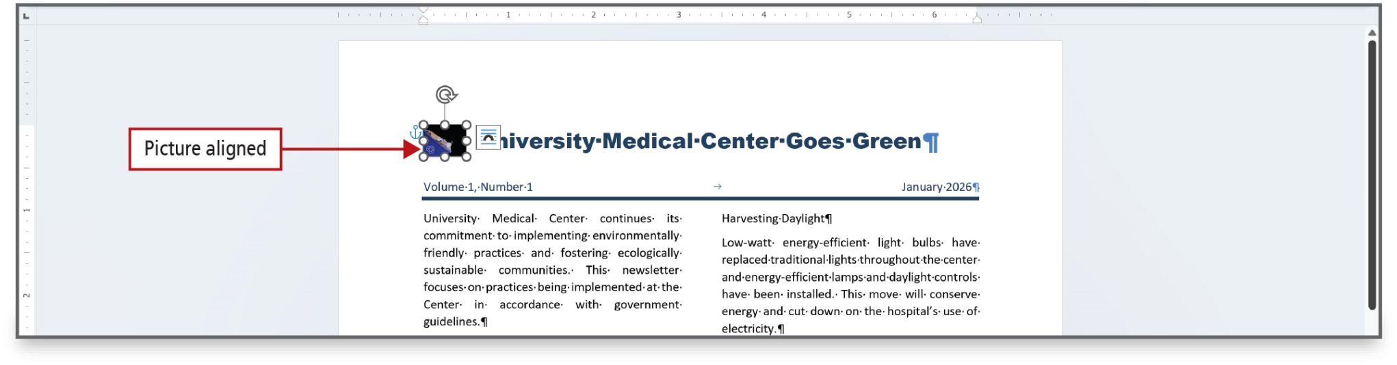
Figure 3.38
Notes:
This figure show the picture has been aligned using the options in the Layout dialog box.

Slide 37
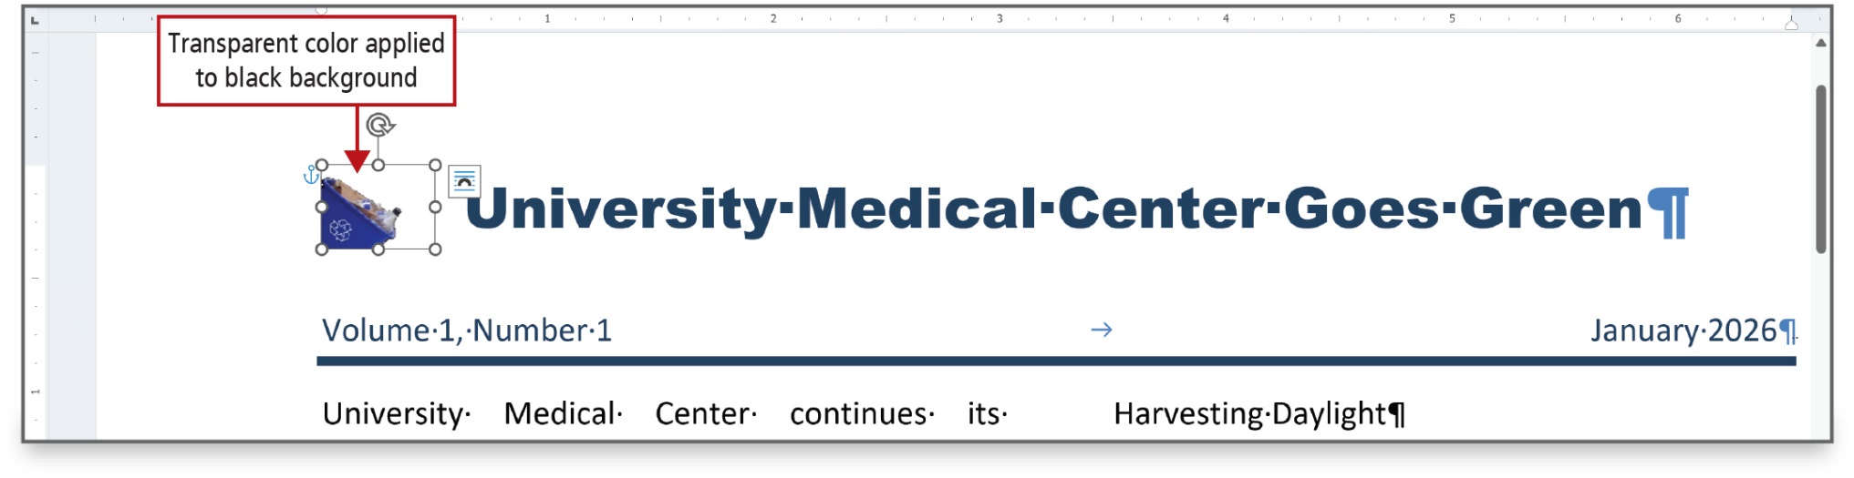
Figure 3.39
Notes:
You can make one color in a picture transparent by using the Set Transparent Color command. When a picture is recolored, all the colors in the picture change to shades of a single color.

Slide 38
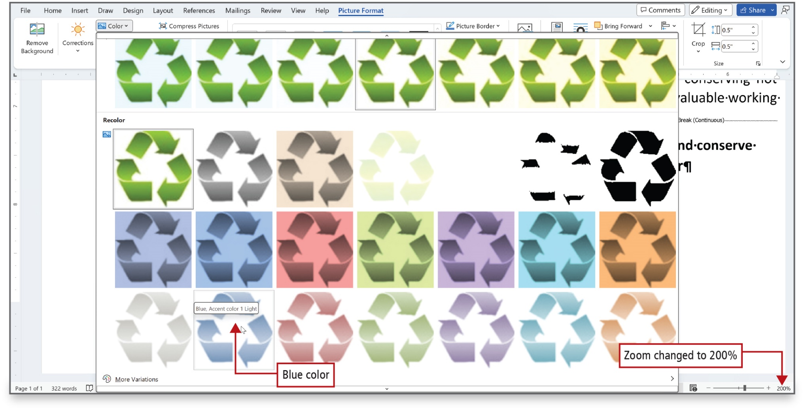
Figure 3.40
Notes:
You can make one color in a picture transparent using the Set Transparent Color command. When you recolor a picture, you change all the colors in the picture to shades of a single color.
Long Description:
The first annotation, blue color, points to the second recycling image in the fourth row of four rows of seven recycling images shown in the Color button menu with various colors. A ScreenTip gives details of that particular image. The second annotation, Zoom changed to 200 percent, points to 200 percent of the zoom bar at the bottom right corner of the screen.

Slide 39
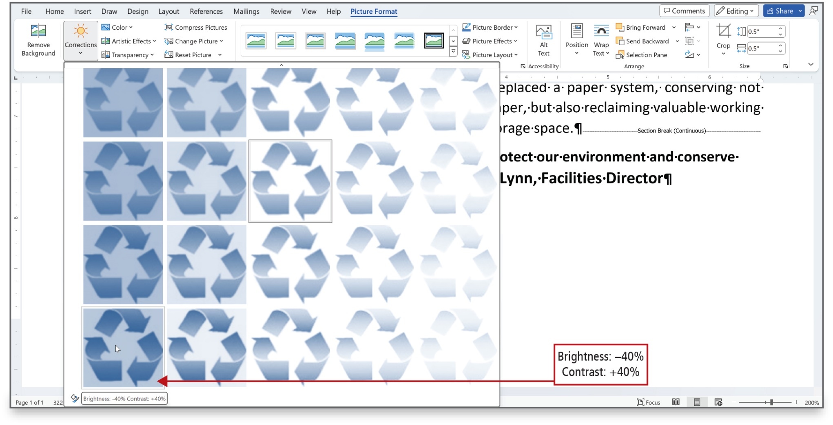
Figure 3.41
Notes:
Brightness, the relative lightness of a picture, and contrast, the difference between the darkest and lightest area of a picture can also be adjusted, as shown in the second image.
Long Description:
The Corrections command on the ribbon is selected. An annotation, Brightness: minus 40 percent and contrast: plus 40 percent, points to the first recycling image in the fourth row of four rows of seven recycling images shown in a tab with blue-shaded colors. A ScreenTip gives details of brightness and contrast of that particular image.

Slide 40
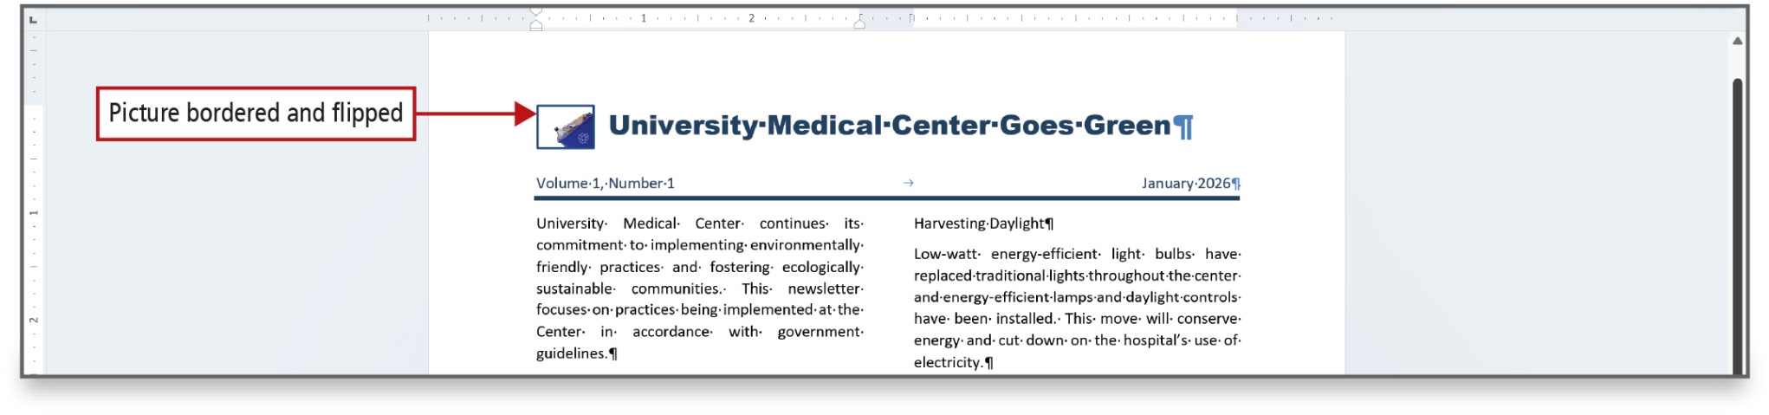
Figure 3.42
Notes:
The flip commands create a reverse image of a picture or object.

Slide 41
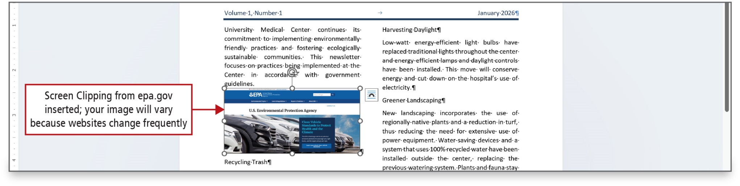
Figure 3.43
Notes:
A screenshot is an image of an active window on a computer that can be pasted into a document. .Screenshots are especially useful when you want to insert an image of a website into your Word document.
A screen clipping is an image on your computer that you can paste into a document.

Slide 42
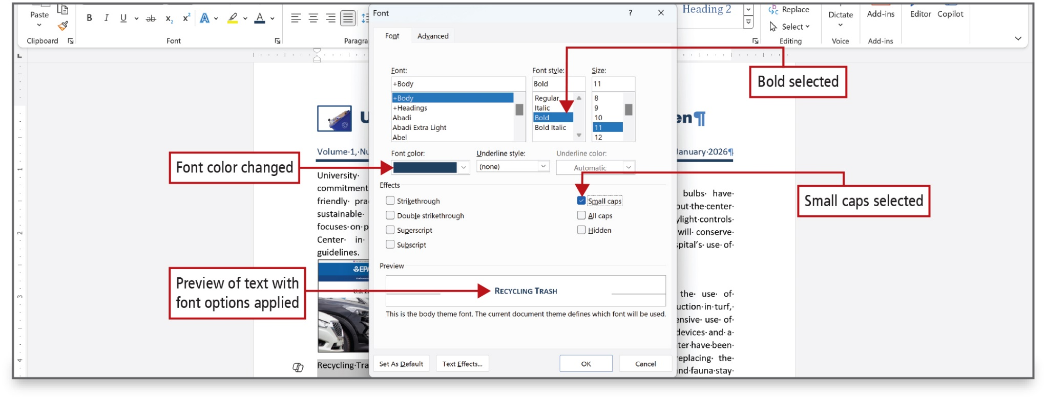
Figure 3.44
Notes:
Special text and paragraph formatting is useful to emphasize text, and it makes a newsletter look more professional.
Small caps is an attractive font effect often used for headlines and titles. The effect changes lowercase letters to uppercase letters, but with the height of lowercase letters.
Long Description:
The Font dialog box has two tabs: Font and Advanced. Font tab is selected. The Font tab in the dialog box has the following: the Font dropdown set to plus body, the Font style dropdown set to Bold, the Size dropdown set to 11, the Font color dropdown, the Underline style dropdown, the Underline color dropdown, the Effects section with checkboxes for strikethrough, double strikethrough, superscript, subscript, small caps (selected), all caps, and hidden, and the Preview section with a preview box. The first annotation, bold selected, points to Bold selected under Font style. The second annotation, font color changed, points to the Font color dropdown menu. The third annotation, small caps selected, points to the check box for small caps in the dialog box. The fourth annotation, preview of text with font options applied, points to the preview box in the Preview section.

Slide 43
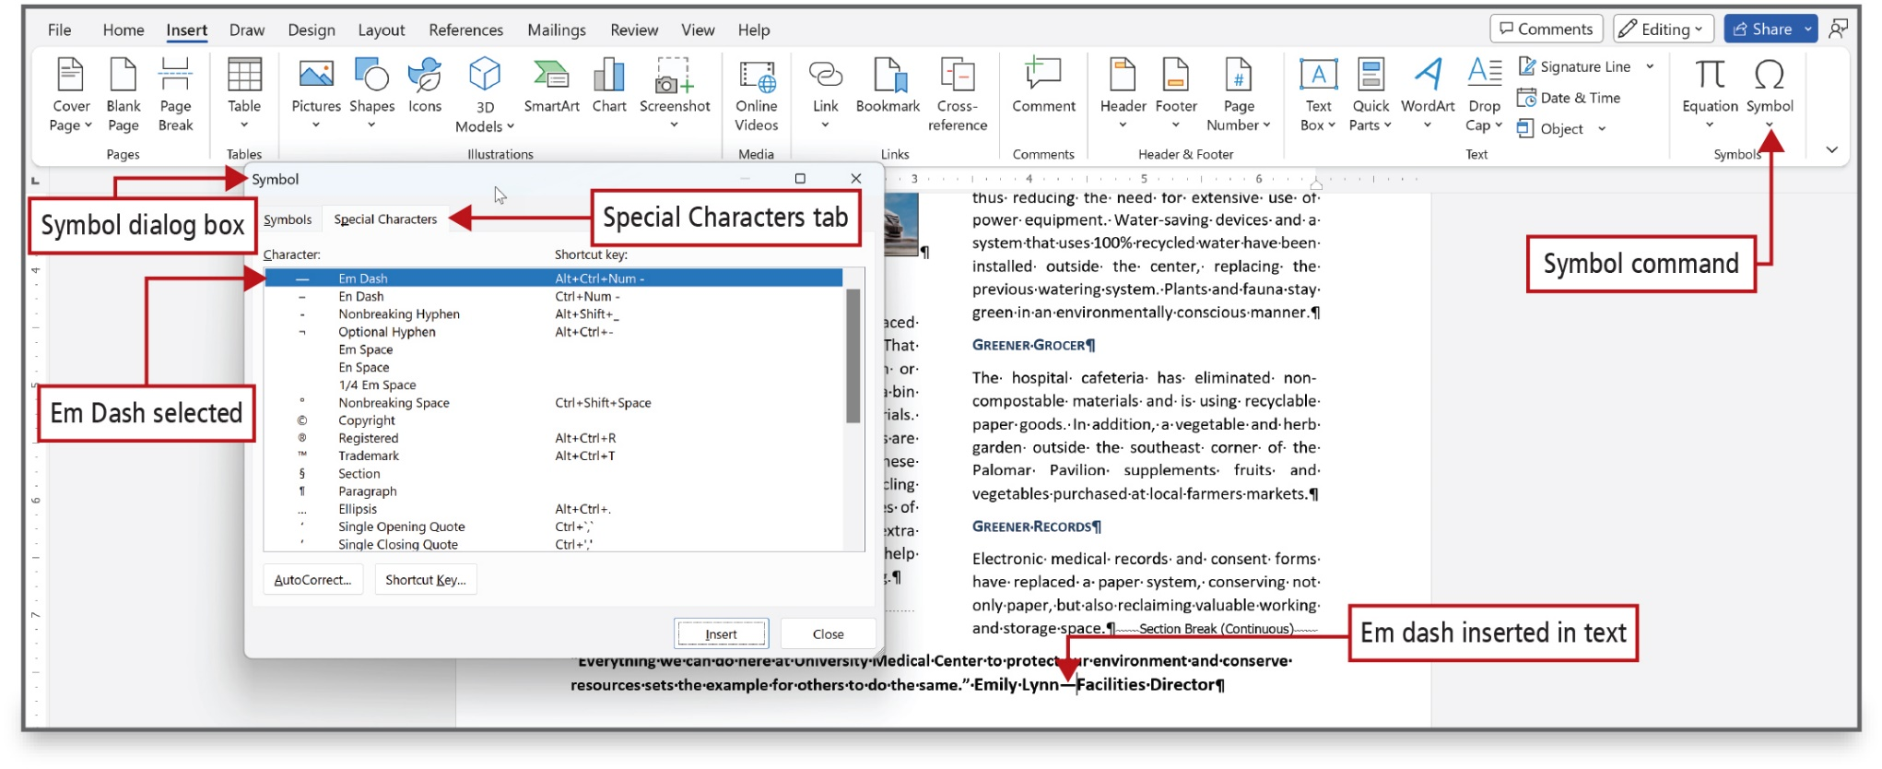
Figure 3.46
Notes:
Symbols and special characters can be inserted into a Word document. Symbols such as the copyright symbols, trademark symbol, and em dashes—a punctuation symbol used to indicate an explanation or emphasis—are all available in Word.
Long Description:
The first annotation, symbol command, points to the Symbol button shown an ohm symbol at the right end of the ribbon. The Symbol dialog box opens up with two tabs (Symbols, Special characters) in which Special characters is selected. The second annotation, Symbol dialog box, points to the title: Symbol in the dialog box. The third annotation, Special Characters tab, points to the Special Characters tab in the dialog box. The Special Characters tab shows a table with characters and their shortcut keys. The fourth annotation, em dash selected, points to the first row (dash, Em dash, Alt plus control plus Num) of the table with characters and their shortcut keys. The fifth annotation, em dash inserted in text, points to the space between the words Lynn and Facilities in the footnote.

Slide 44
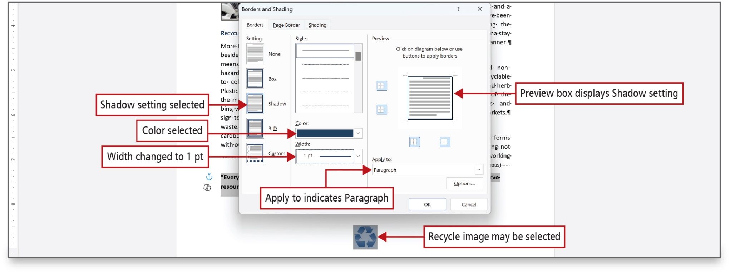
Figure 3.47
Notes:
In the lower right portion of the Borders and Shading dialog box, the Apply to box indicates Paragraph. The
Apply to box directs where the border will be applied.
Long Description:
The Borders and Shading dialog box shows three tabs (Borders, Page Border, and Shading) in which the Borders tab is selected. The Borders tab shows five different settings (None, Box, Shadow, 3-D, and Custom) in the Setting section, five different styles, the Color dropdown, and the Width dropdown in the Style section, and a preview of the border style and the Apply to dropdown menu in which paragraph is selected in the Preview section. The first annotation, Shadow setting selected, points to the Shadow setting under the Setting section. The second annotation, Color selected, points to the color selected in the Color dropdown for border color. The third annotation, Width changed to 1 p t, points to 1 p t selected in the Width dropdown. The fourth annotation, Preview box displays Shadow setting, points to the Preview pane. The fifth annotation, apply to indicates paragraph, points to paragraph selected in the Apply to dropdown. The sixth annotation, recycle image may be selected, points to a recycle image below the footnote.

Slide 45
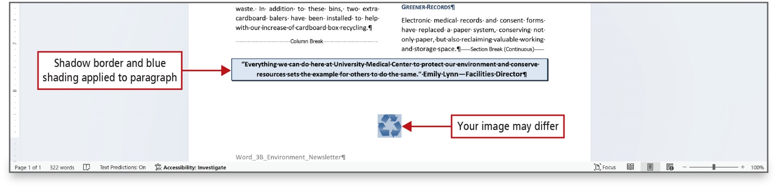
Figure 3.48
Notes:
Paragraph borders provide strong visual cues to the reader. You can use paragraph shading with or without borders; however, combined with a border, light shading can be very effective in drawing the reader’s eye to specific text.
Holding down Shift while selecting Enter inserts a manual line break, which moves the text to the right of the
insertion point to a new line while keeping the text in the same paragraph. A line break indicator, in the shape of a
bent arrow, indicates a manual line break.

Slide 46
Create Mailing Labels Using Mail Merge
Mail merge
Joins main document and data source to create customized letters or labels
Main document
Contains the text or formatting that remains constant
Data source
Contains information including the names and addresses of the individuals for whom the labels are being created
Notes:
Word’s mail merge feature joins a main document and a data source to create customized letters or labels. The easiest way to perform a mail merge is to use the Mail Merge Wizard, which asks you questions and, based on your answers, walks you step by step through the mail merge process.
A Mail merge joins main document and data source to create customized letters or labels. The main document contains the text or formatting that remains constant. The data source contains information including the names and addresses of the individuals for whom the labels are being created.

Slide 47
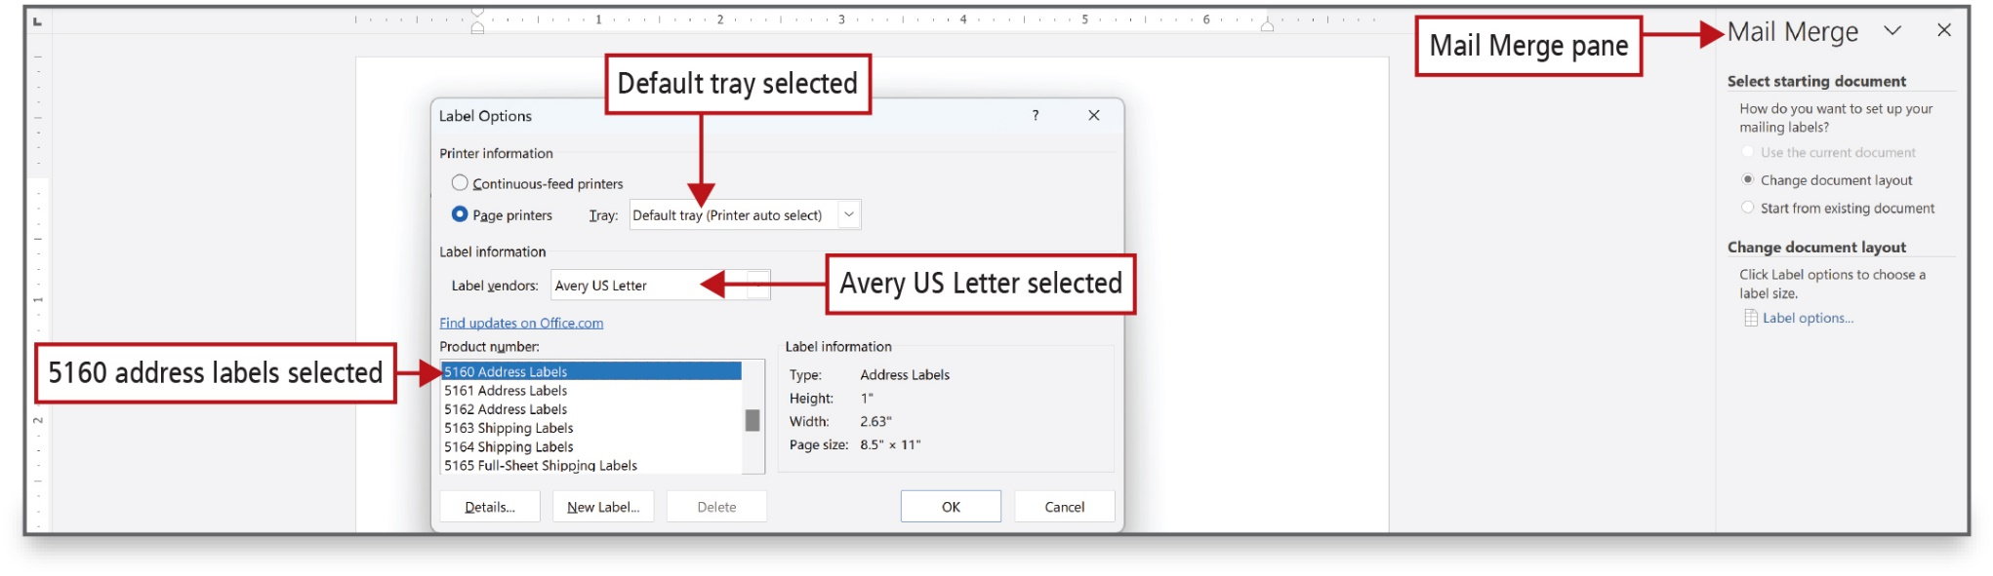
Figure 3.49
Notes:
Begin by selecting the label type. Address labels are defined in the Label Options dialog box. The Avery 5160 address label is a commonly used label.
Long Description:
The Label Options dialog box has the following: Printer information: radio buttons for Continuous-feed printers and Page printers and the tray dropdown in which Default tray (printer auto select) is selected. Label information: the Label vendors dropdown in which Avery U S Letter is selected and the Product number dropdown in which 5160 address labels is selected. Label information on the right of the Product number dropdown. The first annotation at the center, default tray selected, points to Default tray (printer auto select) selected in the Tray dropdown. The second annotation, Avery U S letter selected, points to Avery U S Letter selected in the Label vendors dropdown. The third annotation, 5160 address labels selected, points to 5160 address labels selected in the Product number dropdown. The Mail Merge pane is shown on the right. The fourth annotation, Mail Merge pane, points to the title: Mail Merge of the pane.

Slide 48
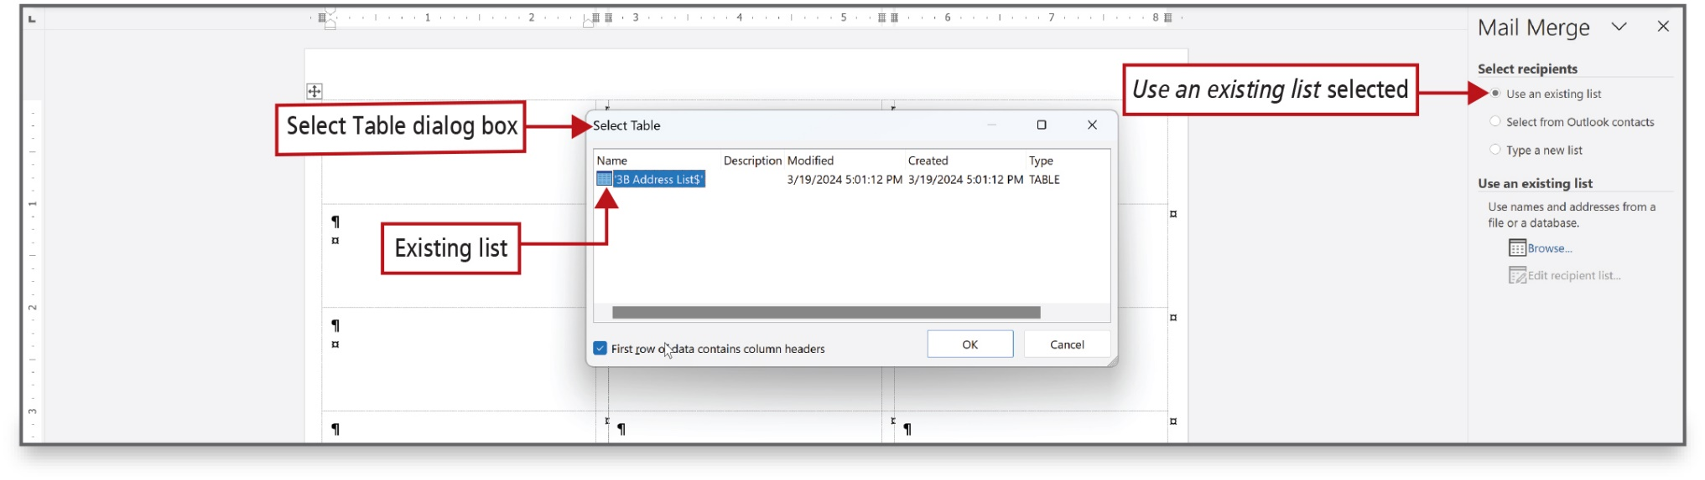
Figure 3.50
Notes:
Each row of information in the Excel worksheet that contains data for one person is referred to as a record. The
column headings—for example, Last Name and FirstName—are referred to as fields.
Long Description:
The Mail Merge pane is shown on the right with the following radio buttons under select recipients: Use an existing list (selected), Select from outlook contacts, and Type a new list. The first annotation, use an existing list selected, points to the radio button for Use an existing list in the Mail Merge pane. The Select Table dialog box shows a table with columns: Name, Description, Modified, Created, and Type. The second annotation, select table dialog box, points to the title: Select Table of the dialog box. The third annotation, existing list, points to the list name under Name column of the Select Table dialog box.

Slide 49
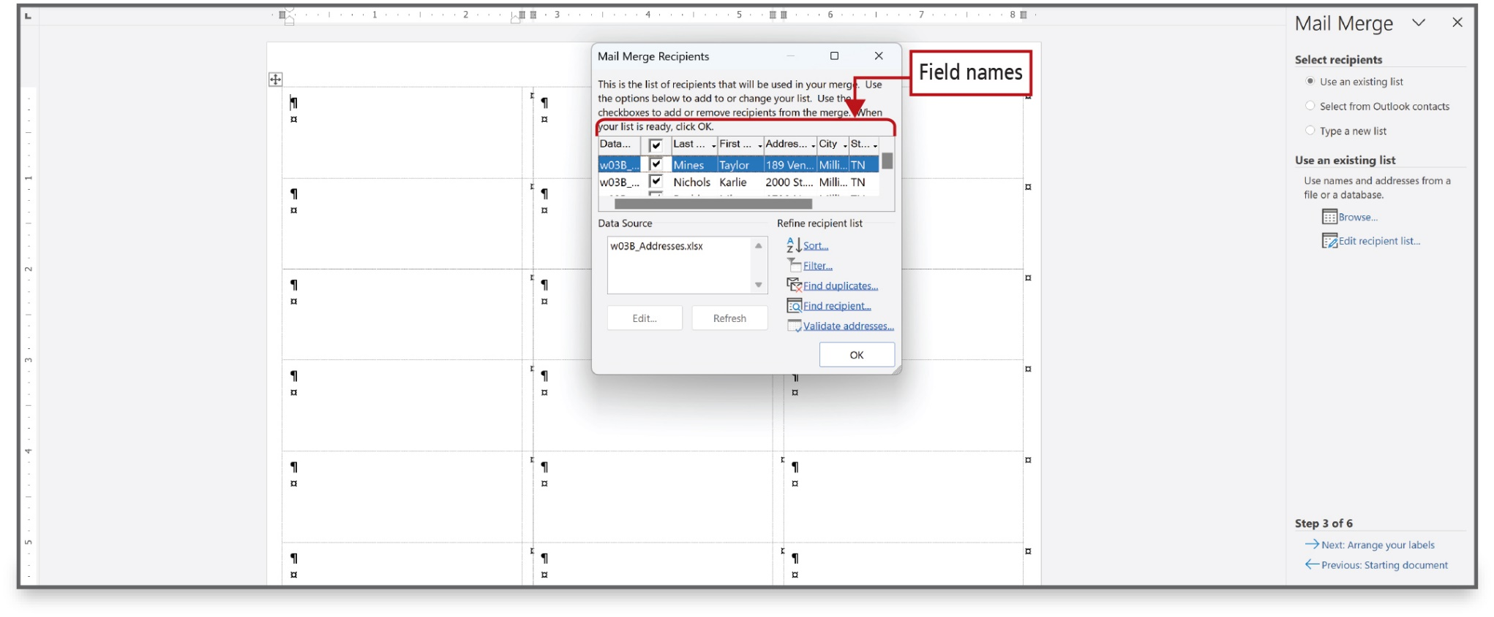
Figure 3.51
Notes:
Once a table has been selected, the Mail Merge Recipients dialog box displays. Here you can perform various actions on the list, such as sorting, filtering, finding duplicates, locating a specific recipient, or validating addresses.

Slide 50
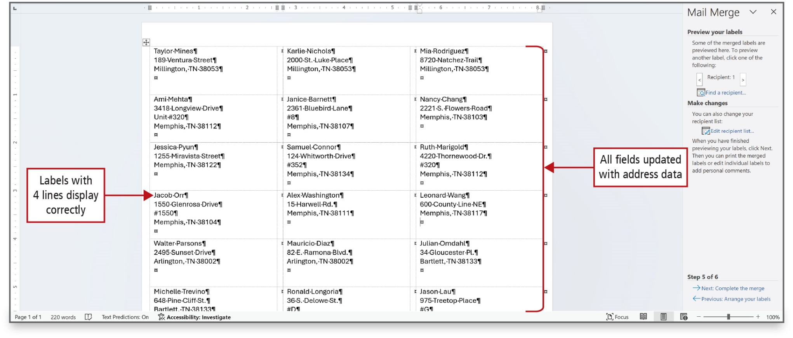
Figure 3.53
Notes:
Clicking "Next" in the Wizard completes the label creation and you get a new document.
Word inserts the Address block in the first label space surrounded by double angle brackets. The AddressBlock field name displays, which represents the address block that is seen in the Preview area of the Insert Address Block dialog box.
Long Description:
The first annotation, labels with 4 lines display correctly, points to an address in column 1 of row 4. The second annotation, all fields updated with address data, points to the addresses in column 3 of rows 1 to 6.

Slide 51
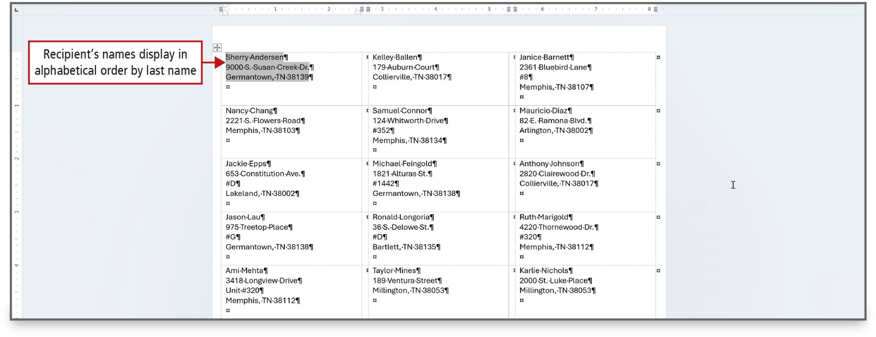
Figure 3.54
Notes:
Mailing labels are often sorted by either last name or by ZIP Code. In this case, the labels are sorted in alphabetical order.

Slide 52

Questions

Slide 53

Copyright
This work is protected by United States copyright laws and is provided solely for the use of instructors in teaching their courses and assessing student learning. Dissemination or sale of any part of this work (including on the World Wide Web) will destroy the integrity of the work and is not permitted. The work and materials from it should never be made available to students except by instructors using the accompanying text in their classes. All recipients of this work are expected to abide by these restrictions and to honor the intended pedagogical purposes and the needs of other instructors who rely on these materials.

